Slide 1
A Handy Approach to Care
Adapting constructively to loss
Dr Liliana Risi
GP Clinical Lead Medicines Optimisation
Tower Hamlets CCG
Barts Health
12 June 2018
LRISI@nhs.net
Declaration – no conflicts of interest financial or religious
http://www.whopaysthisdoctor.org/doctor/390

Slide 2
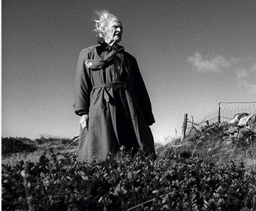
Subjective – Objective
Frail person?
Frail community?
Frail system?
POET - RS THOMAS at his home on the LLYN PENINSULA September 1997 (1)
Living well at the End of Life. Adapting Health Care to serious chronic illness in old Age. (RAND 2003)
The End of the Disease Era (Am J Med 2004)
Medical care for the final years of life: "When you're 83, it's not going to be 20 years” (JAMA 2009)
Epidemiology of multimorbidity and implications for health care, research, and medical education (Lancet 2012)
‘I told you I was ill’
SPIKE MILLIGAN
(1) https://howardbarlow.photoshelter.com
Notes:
Spectrum of function
Epidemiology of multimorbidity and implications for health care, research, and medical education
Onset of multimorbidity occurred 10–15 years earlier in people living in the most deprived areas compared with the most affluent

Slide 3
What is ‘person centred’ care?
Many definitions – and patients generally not involved in defining what it means http://www.health.org.uk/publications/helping-measure-person-centred-care/
‘Personhood’ (Kitwood) - Pioneer in the field of dementia care: ‘rights-based’ approach
  (Dementia Reconsidered 1997)
‘Personhood’ transcendent, sacred, and unique; and that it accords people (who have dementia) with an ethical status to be treated ‘with deep respect’

Slide 4
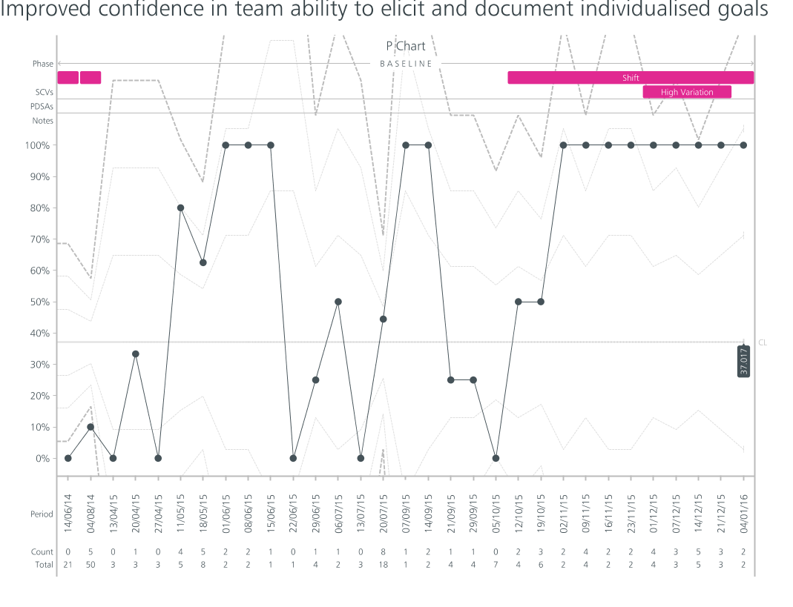

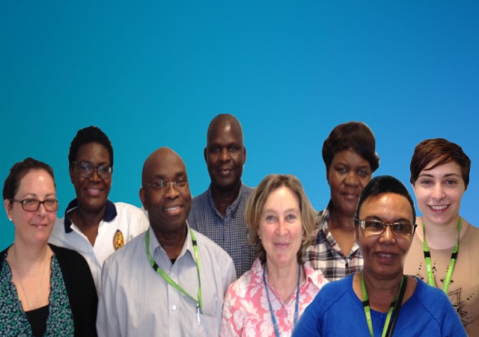
KEY
CS = Clinical Supervision
FT= Flash Teaching
HA =Handy Approach
Phase 4 TC= Team Consolidation
Phase 5 TS=Team Stability
TS
Phase 5
TC
Phase 4
FT
PDSA 2
Keeping people well at home
HA
PDSA 3
CS
PDSA 1
Charity Tshuma (Community Psychiatric Nurse), Cynthia Tomu (Community Matron), Depala Babalal (Consultant Care of the Elderly), Laura Jones (Occupational Therapist), Okumu Ogwal (Social Worker), Oladimeji Adekunle (Community Matron) Abi Olowosoyo (Physiotherapist), Maloles Munoz-Cobo (Care Navigator), Liliana Risi (General Practitioner)
ELFT CHN Central Cluster Virtual Ward Team
BMJ: The Handy Approach - Quick Integrated Person Centred Support Preparation
http://qir.bmj.com/content/6/1/u214461.w5681.full
Notes:
Frailty Spectrum – Frailty tools time consuming and over detailed
A review of assessments for frailty done by the QI lead found that multiple tools existed to assess frailty with different intentions and that the tools: tended towards too much detail; were expensive to do as they demanded a lot of time from the person being assessed and from professionals to record; were dominated by biomedical information, tended not to capture wellness and few incorporated personal aspirations
Foundation framework for integrated caring
Form of simulation for teams
Quick impression of the lived life
Data teams
Why team working is so critical to person-centred care
Change ideas were developed by the team and included Enhanced Clinical Supervision which had no effect initially, Flash Teaching which was well received but had minimal effect, a structured approach to formulation through an integrated framework, the Handy Approach, which increased the percentage of assessments that included documented aspirations for care, and attention to ‘Team Primacy’ which enabled us to consolidate earlier work and achieve our goal of 100% of assessments having personal aspirations documented.

Slide 5
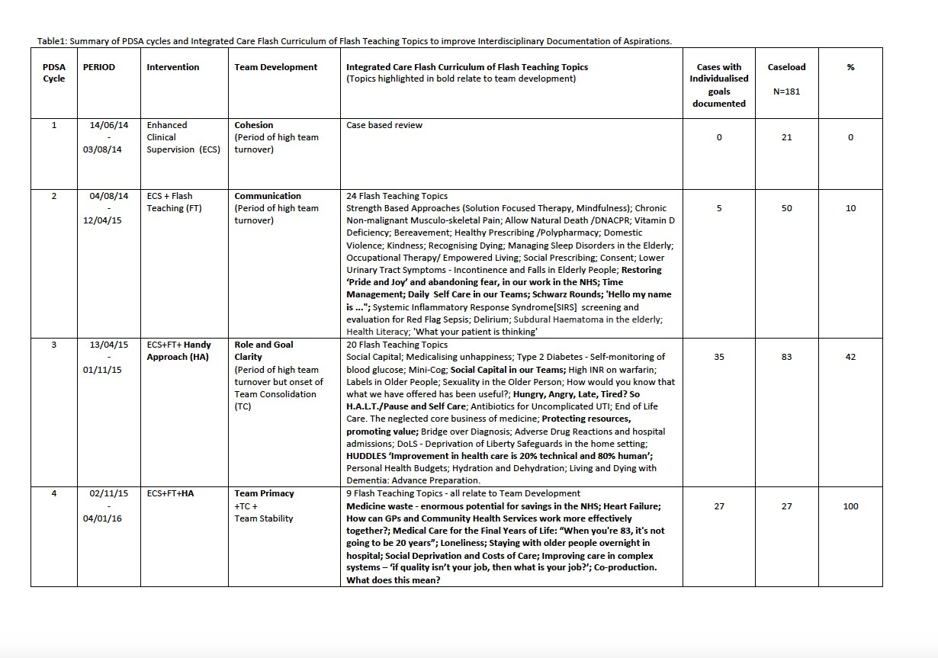
Keeping people
well at home

Slide 6
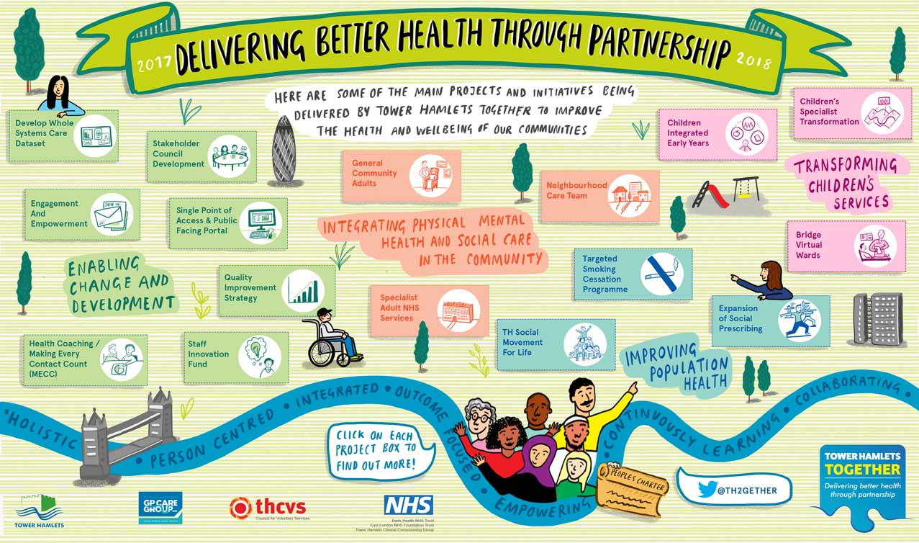

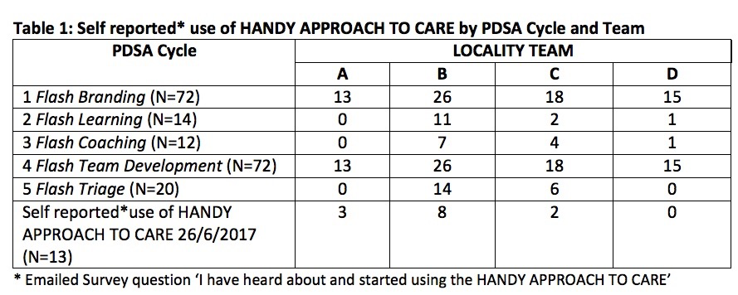
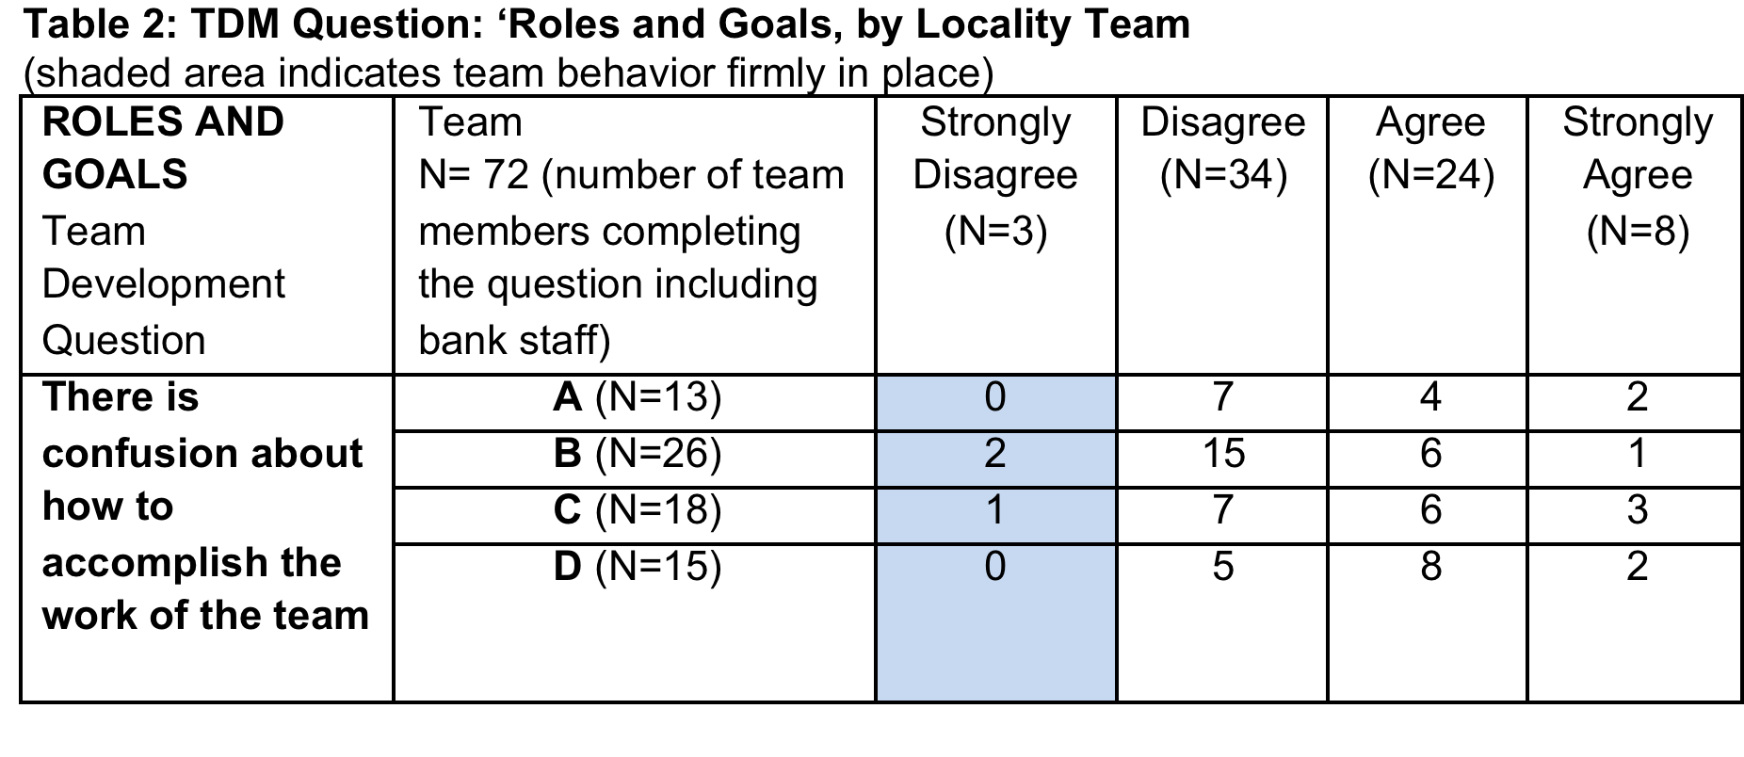
Quick ways of learning
in time limited environments
CHS Tower Hamlets
https://qi.elft.nhs.uk/collection/tower-hamlets-community-health-services/
Notes:
Complaints /Datix analysis, managers noticed how useful Handy Approach notes were recorded
Design Question
How can a person-centred integrated framework, called the HANDY APPROACH TO CARE, be taught in an organisation undergoing change where time to learn is limited by competing demands?

Slide 7
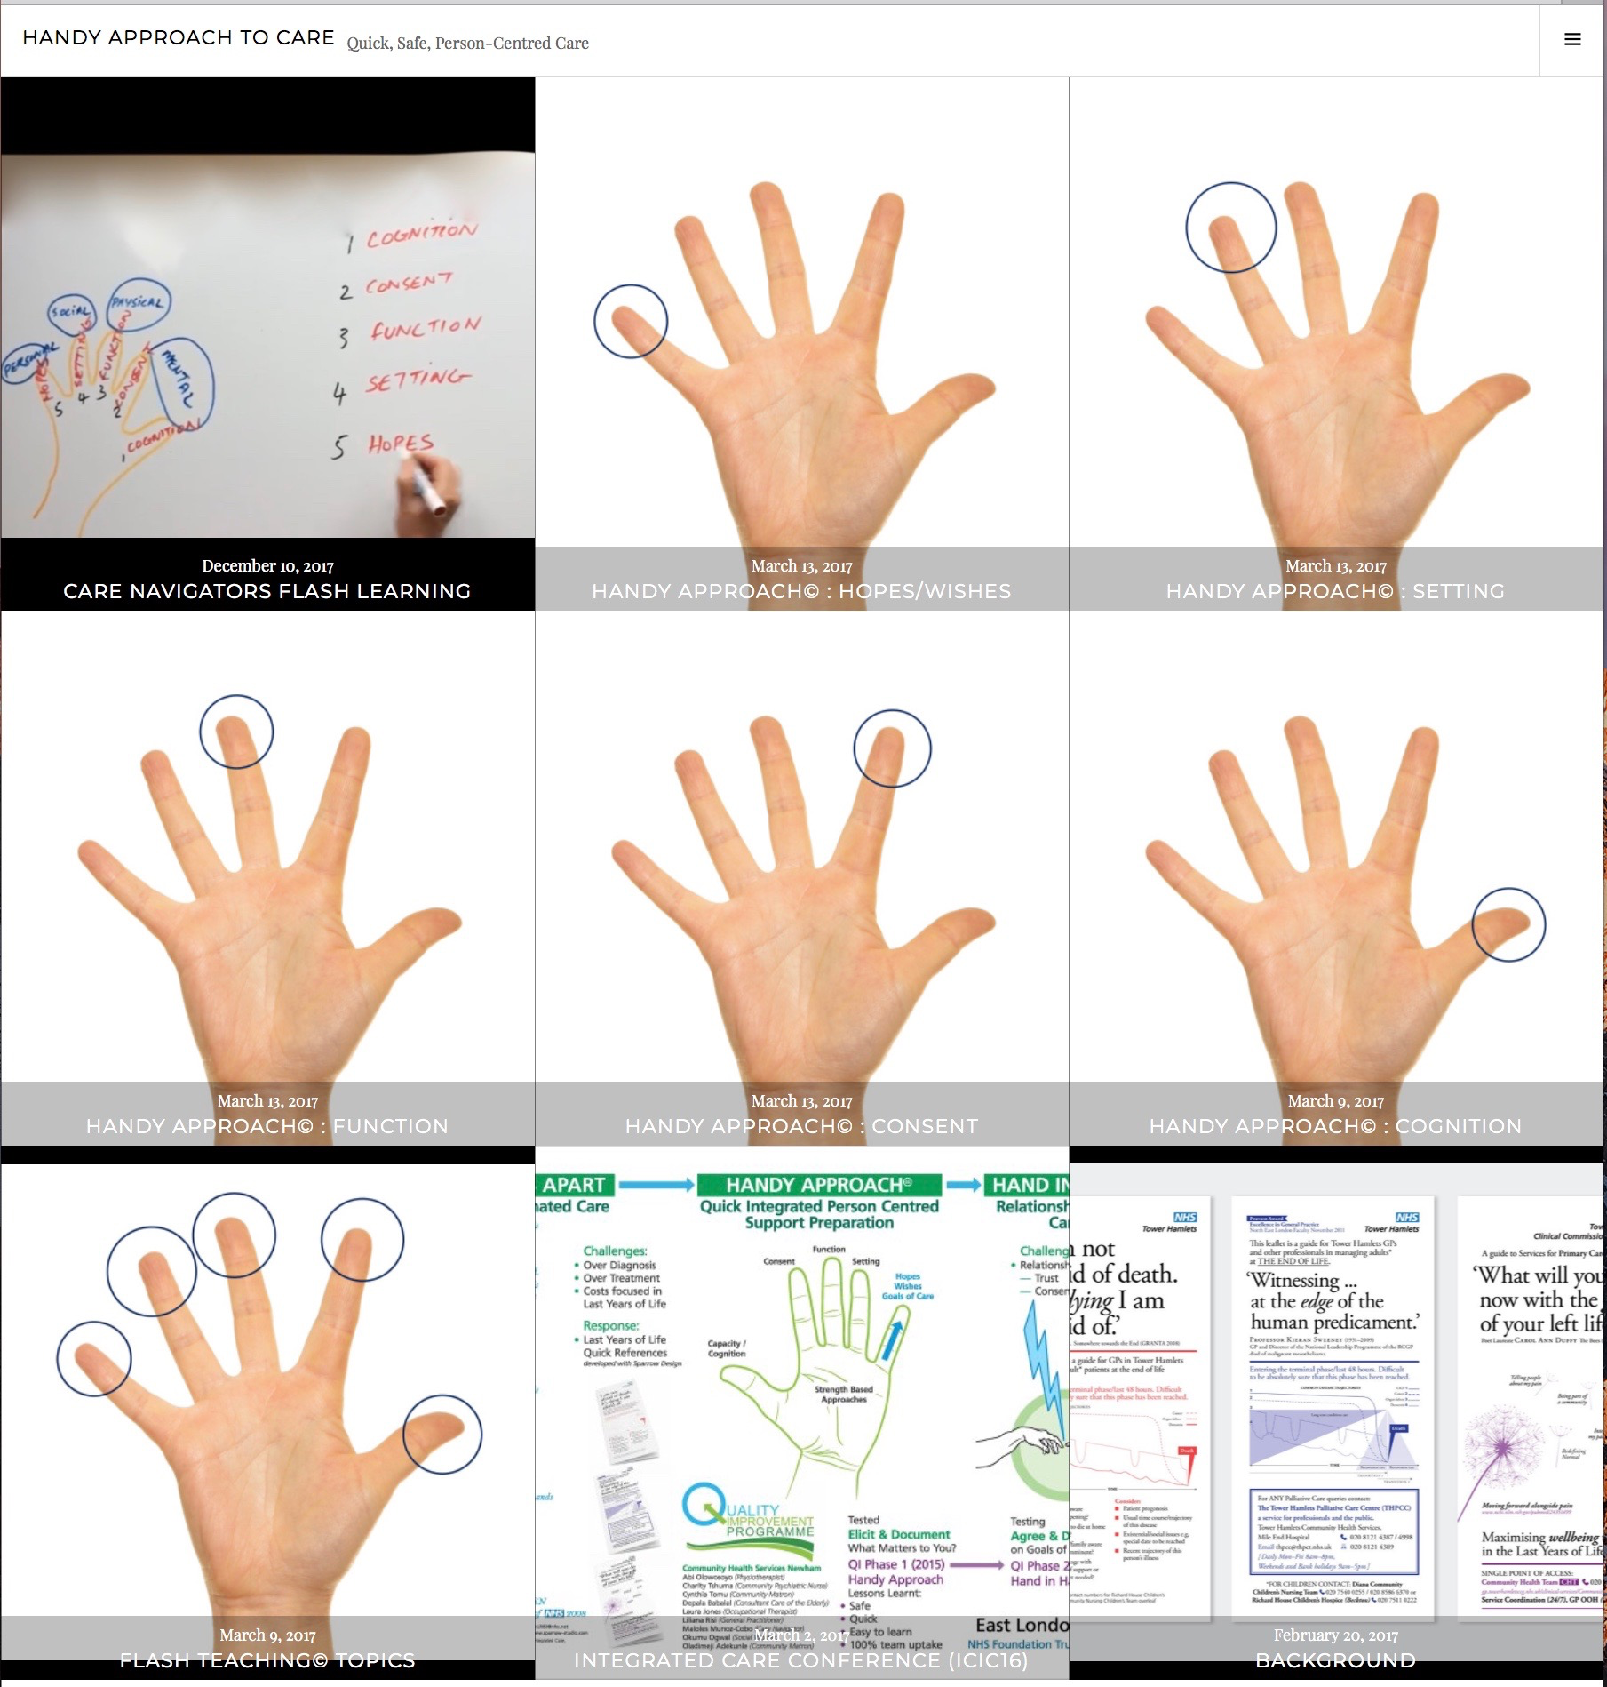
APP https://handyapproachtocare.com/
Impression of Jean’s Lived Life in a checklist of 5 questions:
1.* Can Jean remember what she did yesterday?
2. Has she given us permission to be involved in her care?
3.*Is she able to get out of bed?
4.*Is she alone at night?
5. What matters to Jean on a good day?
*Alerts highlight risks
ATTRIBUTION A Handy Approach to Integrated Care Co-production by Liliana Risi LRISI@nhs.net Licensed under a Creative Commons Attribution Non-commercial non-derivatives 4.0 International Licence 2016.
Notes:
All decisions about me with me
Test handover real time high need cohorts

Slide 8
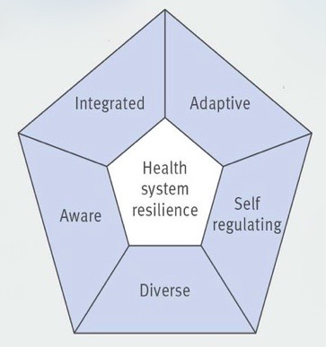
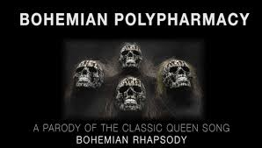

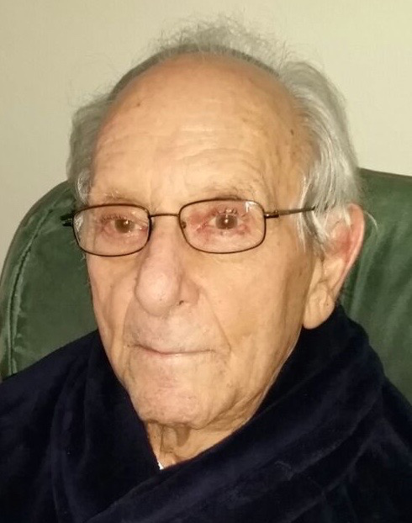

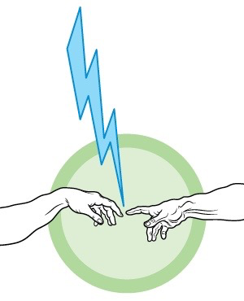
TEAM MISSION: Adapting constructively to loss
Therapeutic Nihilism
Too much Medicine
Lazarus
Shared Decisions
Proportionate
Respectful
Equitable
Sparrow
Dynamics of Dignity and Safety (BMJ Quality and Safety 2018) Building resilient health systems (BMJ 2017)

Slide 9
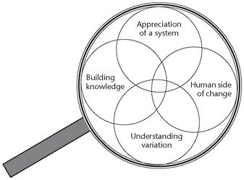
TEAM MISSION:
Adapting constructively to loss
'Never doubt that a small group of thoughtful, committed citizens can change the world; indeed, it's the only thing that ever has'
Margaret Mead - Cultural Anthropologist (1901 –1978)

Slide 10
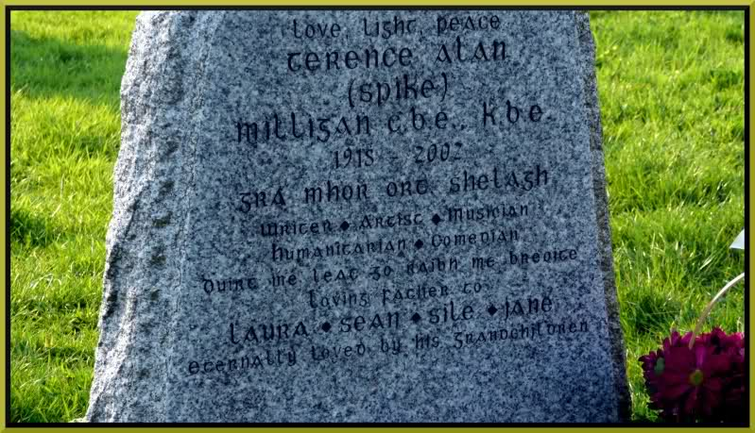
Spike Milligan
b.1918 - d.2002
Dúirt mé leat go raibh mé breoite, Irish for "I told you I was ill."
Notes:
And to finish with some wisdom from Spike Milligan

