Slide 1

General Practice Micro-teams in Tower Hamlets
Fresh Doctors and Cost Effective Care
Liliana Risi
GP Clinical Lead Medicines Optimisation Tower Hamlets CCG
Balvinder Kullar
Practice Manage and Member Tower Hamlets GP Care Group
LRISI@nhs.net
Kings Fund London 19 June 2018
https://www.kingsfund.org.uk/events/reimagining-general-practice
Declaration: No conflicts of interest
http://www.whopaysthisdoctor.org/doctor/390

Slide 2
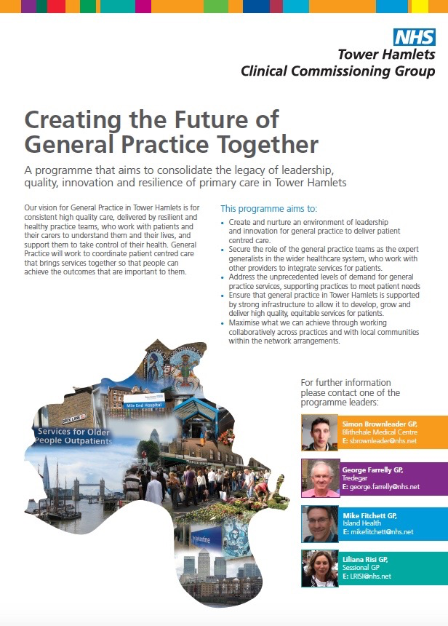
22nd January 2014
Notes:
http://www.towerhamletsccg.nhs.uk/Achieving_Excellence_in_General_Practice_in_Tower_Hamlets_strategy_final.pdf

Slide 3
Drivers for establishing Micro-teams
Case reviews in two large (>12 000 patients) high (QOF) performing practices
  Cancer (Oct 2011): Up to 8 different GPs were involved over the course of the year, in addition to the named GP, before a diagnosis of advanced cancer (J R Soc Med 2013 )
  Dying in Hospital (April 2012): Up to 10 different GPs were involved over the course of the year prior to dying in hospital, in addition to the named GP, but no key GP or Team of GPs was identified to oversee a care plan (>20 different GPs work in this practice)
Other
  Obligation: Informing over 75yrs of their named GP
  Workforce:
    Maximise effectiveness of predominantly part time GP workforce
    Practice size range from 20 800 - 1 303 patients (15/36>10 000 patients)
    1.4 M consultations/year (280 000x5/year)* Social disadvantage
    >900 000 consultations delivered by GPs working in a 'sessional' capacity
    ‘Back room’ function (HR, supplies etc.) and ‘front room’ function how best to manage uncertainty and risk through continuity of:
      Information,
      Management
      Relationship
    Restore ‘ownership and control’
      >70 % (>200/300) are Sessional GPs (pilot workforce data)
      Succession planning - age structure of workforce >10% within 5 years of retirement
Notes:
J R Soc Med 2013 Primary care delays in diagnosing cancer: what is causing it and what can we do about it? http://www.ncbi.nlm.nih.gov/pubmed/24108536

Slide 4
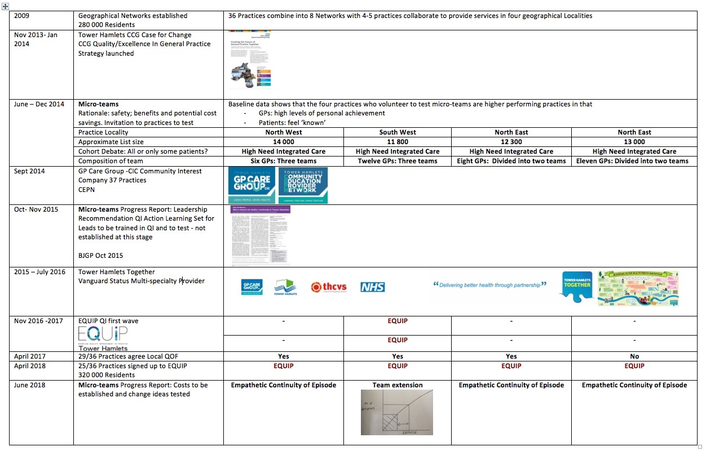
Front Office and Back Office Functions: Tower Hamlets Micro-teams in context

Slide 5
Relational Continuity
Highly valued by:
  most patients (Jeannie Haggerty) http://www.annfammed.org/content/11/3/262.short
  GPs - consistently selected as the most important factor
    The Future of General Practice 2015 15,560 respondents http://nhsconfed.org/resources/2015/04/bma-publish-survey-on-future-of-general-practice
  Secondary Care https://www.rcplondon.ac.uk/press-releases/quarter-physicians-say-continuity-care-poor-their-hospital
Cost Effective - reduced costs through less: prescriptions; tests A&E attendance; hospital admissions and more (Kings Fund 2010;BMJ 2017)
Notes:
Association between continuity of care in general practice and hospital admissions for ambulatory care sensitive conditions: cross sectional study of routinely collected, person level data BMJ 2017 https://www.bmj.com/content/356/bmj.j84
Kings Fund 2010
http://www.kingsfund.org.uk/sites/files/kf/field/field_document/continuity-care-patient-experience-gp-inquiry-research-paper-mar11.pdf
Reduced costs: prescriptions, tests, A&E attendance, and hospital admissions (Wasson et al 1984, Hjortdahl and Borchgrevink 1991, Sweeney and Gray 1995, Mainous and Gill 1998). A recent Dutch study found that newly registered patients used more heath care resources during their first year with a practice than in subsequent years (Jabaaij et al 2007).
One of the main drivers for reducing longitudinal continuity in general practice has been the desire of a group of clinicians to share workload equally (Freeman 1985). However, discontinuity may also have costs. Patients reluctant to wait have to see the least sought-after clinicians, who may be new partners, trainees, locums, or just plain unpopular (Freeman 1989). Most GPs are familiar with the downside of locums: patients coming back to their usual doctor for a second opinion about the same problem, thus causing duplication and waste. This phenomenon is well known but not yet quantified by systematic study. Conversely, in a US setting some patients with long-term conditions expressed a willingness to pay more for continuity (Pereira and Pearson 2003)

Slide 6
If evidence so strong why have practices not embraced micro-teams?
Variation in understanding what is delivered in General Practice
Variation in leadership and decision making across practices
Lack of integrated data to describe waste in the system

Slide 7
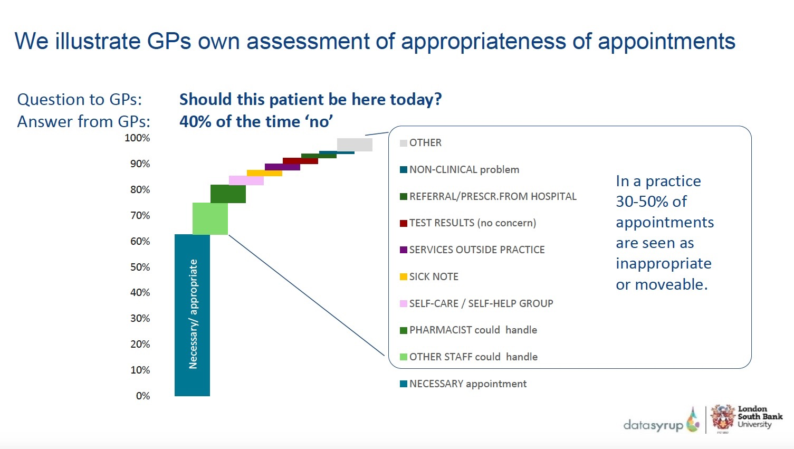
Malby Downham and Hufflett. 2016 London Primary Care Quality Academy. London South Bank University R.Malby@lsbu.ac.uk

Slide 8
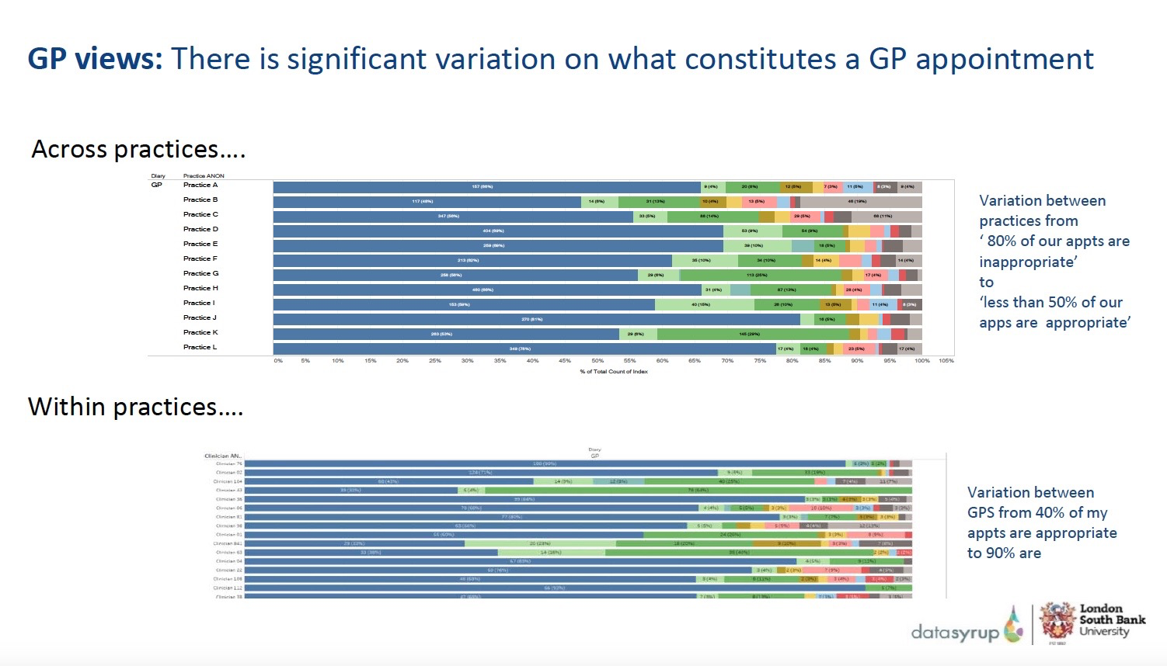
Malby Downham and Hufflett. 2016 London Primary Care Quality Academy. London South Bank University R.Malby@lsbu.ac.uk

Slide 9
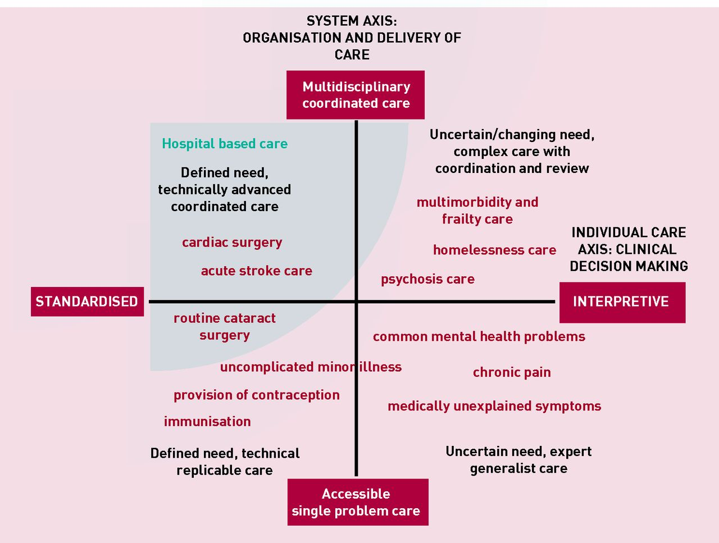
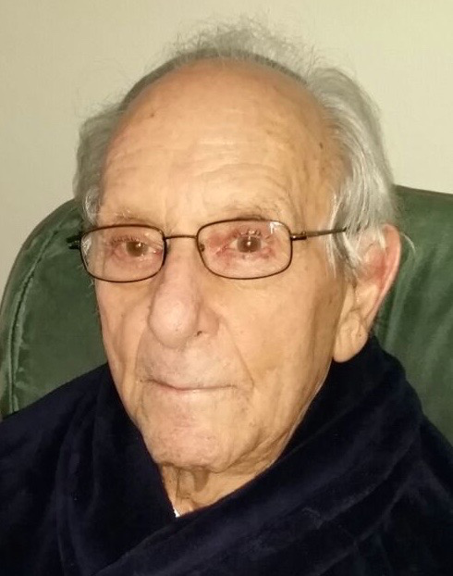
Managing Uncertainty and Coproduction of Care
Realising the full potential of primary care:
uniting the ‘two faces’ of generalism. BJGP 2017
Joanne Reeve and Richard Byng
Notes:
Realising the full potential of primary care: uniting the ‘two faces’ of generalism BJGP 2017
Joanne Reeve and Richard Byng
http://bjgp.org/content/bjgp/67/660/292.full.pdf
The ‘Systems Axis’ (on the Y axis) describes a continuum from single problem accessible care through to integrated coordinated care bringing different skills and TEAMS together.
The ‘Individual Care Axis’ (on the X axis) recognises a continuum from standardised, replicable and often evidence informed, to highly-individualised interpretative care. This axis recognises that standardised disease-focused (guideline) medical care, even done well, can have a burdensome effect on individuals. Burden comes in many forms; whether as over-investigation and over-treatment, or as a failure to adequately address illness experiences that disrupt daily living (a failure of person-centred care). The two models at each end of the axis represent distinct forms of clinical reasoning that ask different questions and are underpinned by different epistemological approaches. In reality, primary care clinicians are often required to move along the continuum in response to particular patient needs.
We thus describe four quadrants with distinct categories of care provision . ‘Single problem/standardised care’ delivers low intensity accessible care at volume, mainly but not only in primary care; and increasingly achieved through technology- supported self-care (for example, blood pressure monitoring, contraception advice) and deployment of less highly-qualified staff (for example, fractures, minor illness). ‘Integrated/standardised care’ sees well- coordinated teams providing access to, and delivery of, condition-specific treatment whether acute management of myocardial infarction or surgical replacement of joints or valves. In both cases, interpretive skills are a lower priority.
Some patients, for example those with mild to moderate mental health needs or medically unexplained chronic pain need ready access to professionals skilled in interpretive practice. Professionals who are able to integrate biomedical, psychosocial, patient and professional accounts of illness in order to help patients make sense of, and so take an active part in managing, their own health problems. Patients in this ‘Accessible/Interpretive’ quadrant may benefit from signposting to services outside of medical care, but generally don’t need high levels of integrated care across medical teams. Some need ongoing continuity of care, while for others a single contact can provide timely treatment, reassurance or diversion from unnecessary investigation or medicine.
Patients with chronic complex care needs, especially those with diminished capacity to manage daily living (for example, multimorbidity, severe mental illness, homelessness), need both coordinated/ integrated and interpretive care. Medicine in this quadrant requires expert practitioners able to make decisions with patients, and work across teams taking account of shifting needs in the social, emotional, and biological domains. This approach should help prioritise needs and support choices to do less medicine, so avoiding the iatrogenic harm arising from a failure to tailor care to the individual-in-context.

Slide 10
Variation in leadership and decision making across practices
For 17/18 Tower Hamlets CCG offered a local alternative to QOF. Variation in how decision was made with some making the decision with
Only GP partners
All GPs in the practice
All clinicians in the practice (GPs and PNs)
The whole practice team (Clinical and Administrative)
All the practices in the Network

Slide 11
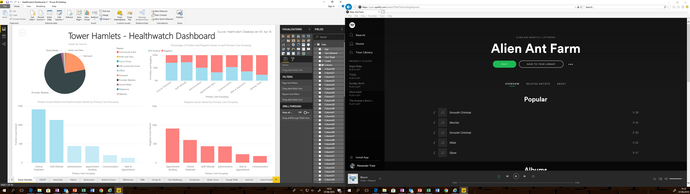
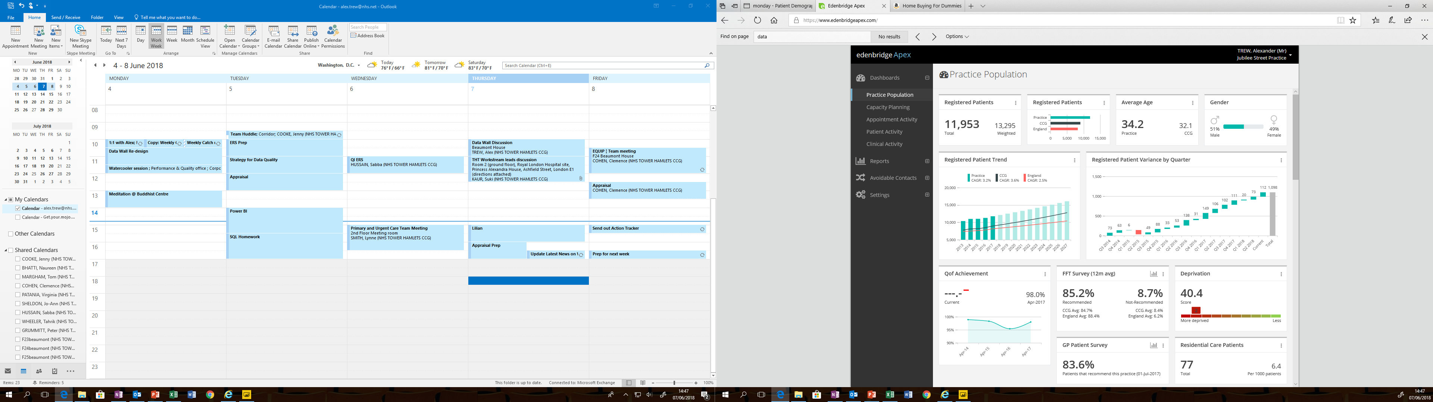

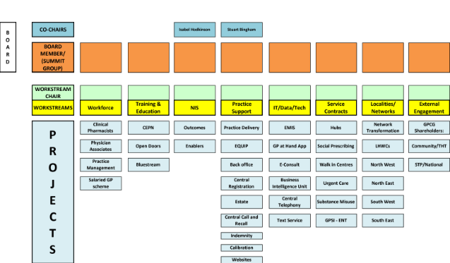
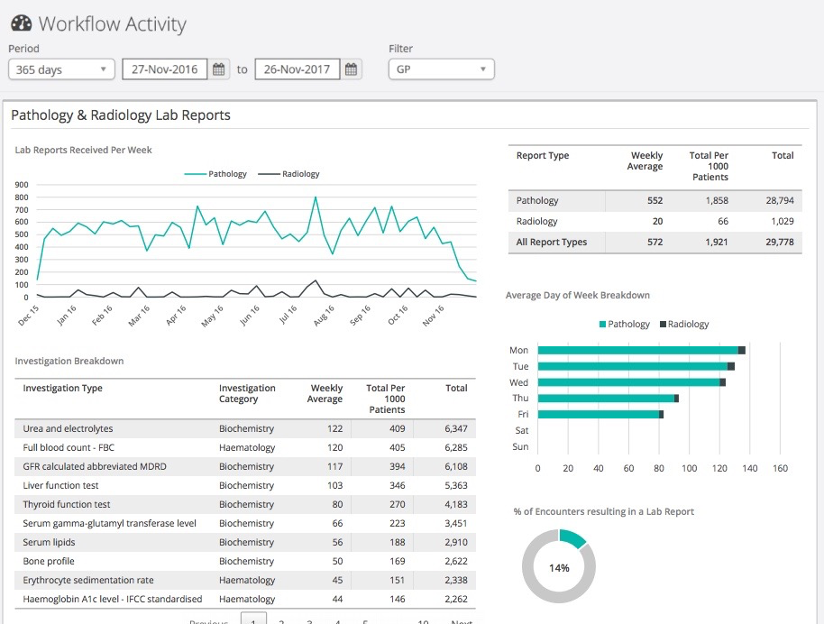
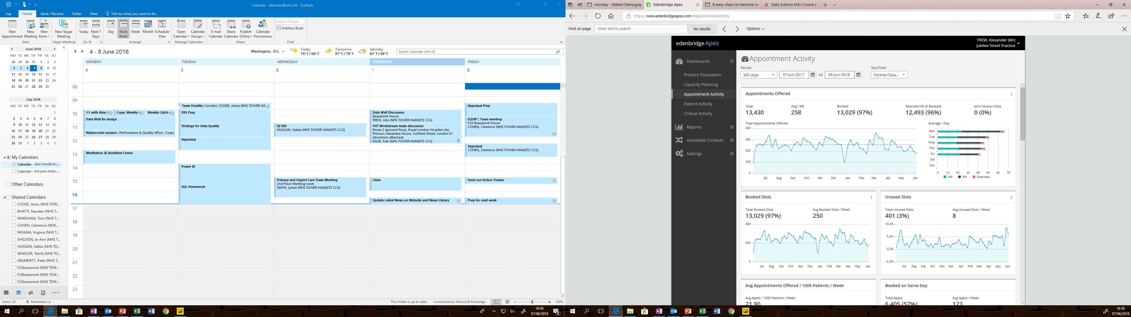
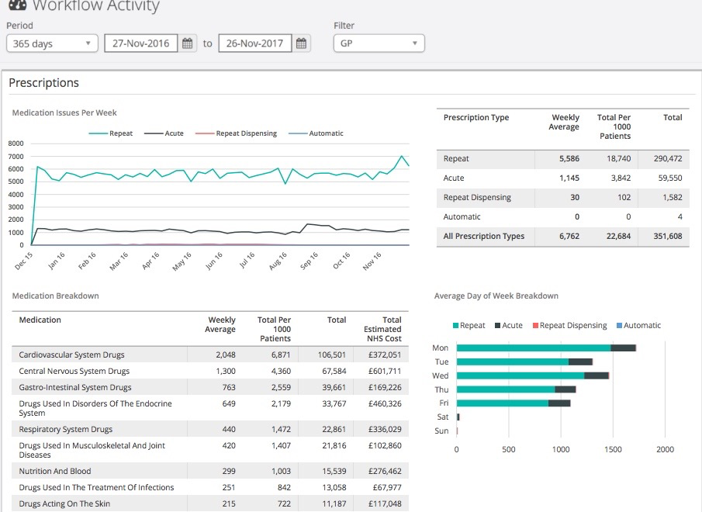
Tower Hamlets Leadership Vision for Real Time Integrated Data
Patient Experience
Practice Population
Primary Care
Development Committee
Diagnostics Activity
Appointment Activity
Medicines Activity

Slide 12
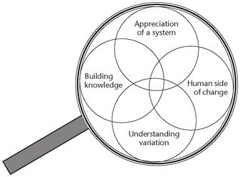
'Never doubt that a small group of thoughtful, committed citizens can change the world; indeed, it's the only thing that ever has'
Margaret Mead - Cultural Anthropologist (1901 –1978)

