Slide 1
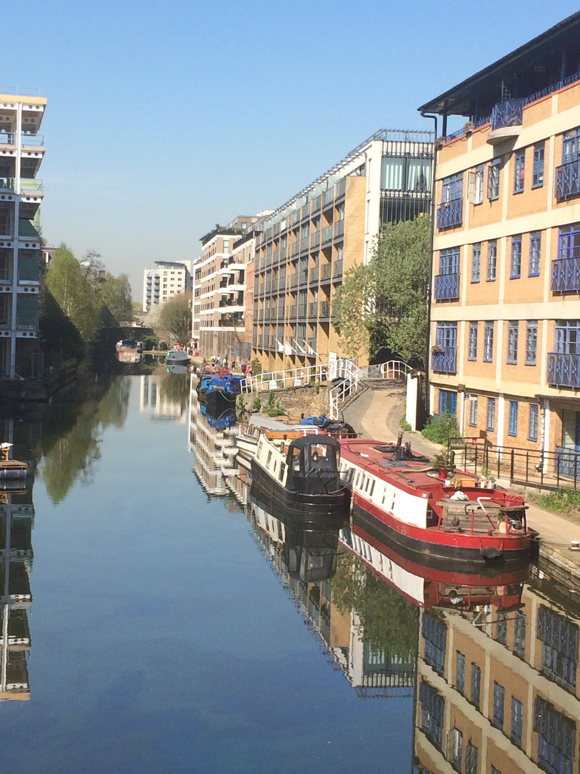
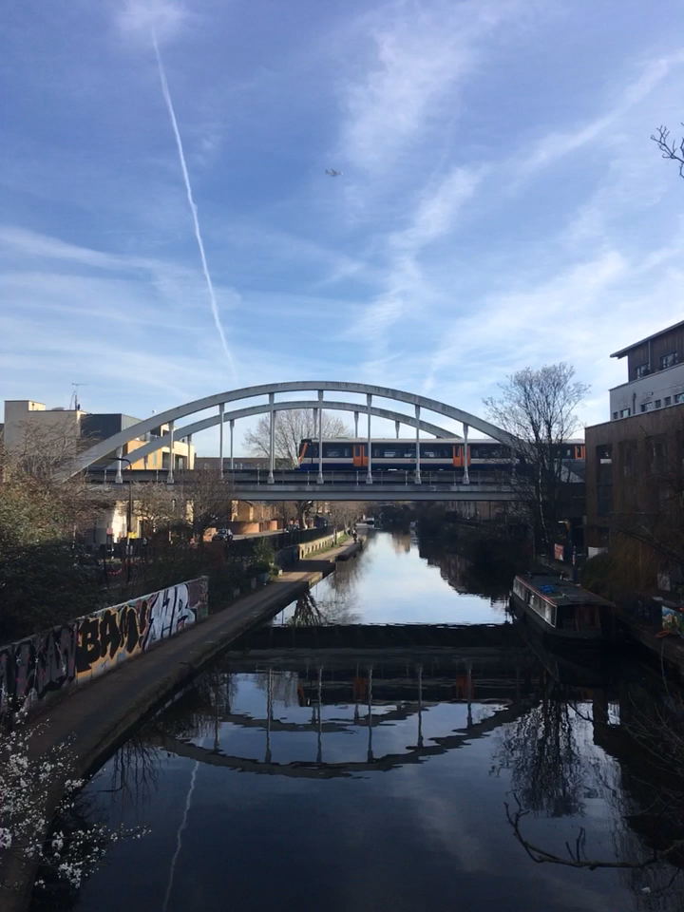

Every decision about me, with me
Adult Safeguarding through the
Life Course
Level 3
City and Hackney Clinical Commissioning Group
11 December 2019
CPD 2 hours
Dr Liliana Risi
CCG GP Clinical Lead Adult Safeguarding
No conflicts of interest
City and Hackney CCG
Handy Approach to Care
Handy Approach to Care

Slide 2

Relationship based care
Hello my name is…
If we want change to happen we need to start with ourselves (Gandhi)
Acknowledge yourself for the hard work that you do daily
Remind yourself that you are ‘purposeful, thinking, feeling, emotional, reflective, relational and responsive’ http://bjgp.org/content/bjgp/66/652/582.full.pdf
‘relationships will be the foundation of healthcare’s new age’ ( Berwick: 9 steps to the Moral Era) http://www.ihi.org/about/news/Pages/ChronicleofHealthCreation.aspx
Abandon unhealthy perfectionismhttps://www.researchgate.net/publication/221715732_Perfectionism_in_doctors
Kate Granger
https://www.hellomynameis.org.uk

Slide 3
Adult Safeguarding Learning
Every decision about me, with me
Level 3 Safeguarding Learning is mandatory for all clinical staff
Required 8 hours Adult Safeguarding Training every three years
Learning themes for this session
  Aware of new concepts in Safeguarding
  Engaging with uncertainty and ambivalence
  Developing responsible curiosity
  Working safely within the Mental Capacity Act
  Minimising Handovers
  Primary Care Networks for integrated system learning not blame

Slide 4
Important Contact Information
Share your concerns with
  Colleague/s in your practice
  Practice/Network Safeguarding Lead
  Social care
    London Borough of Hackney Adultprotection@hackney.gov.uk Tel 0208 356 578
    City of London adultsduty@cityoflondon.gov.uk Tel 0207 332 1224
  C&H CCG Team
    Janette Clarke – Designated Adult Safeguarding Lead Email: janette.clark3@nhs.net Tel: 0208 208 3245
    Dr Liliana Risi – GP Clinical Lead Adult Safeguarding Email: LRISI@nhs.net
Notes:
Include flow chart hand out.

Slide 5

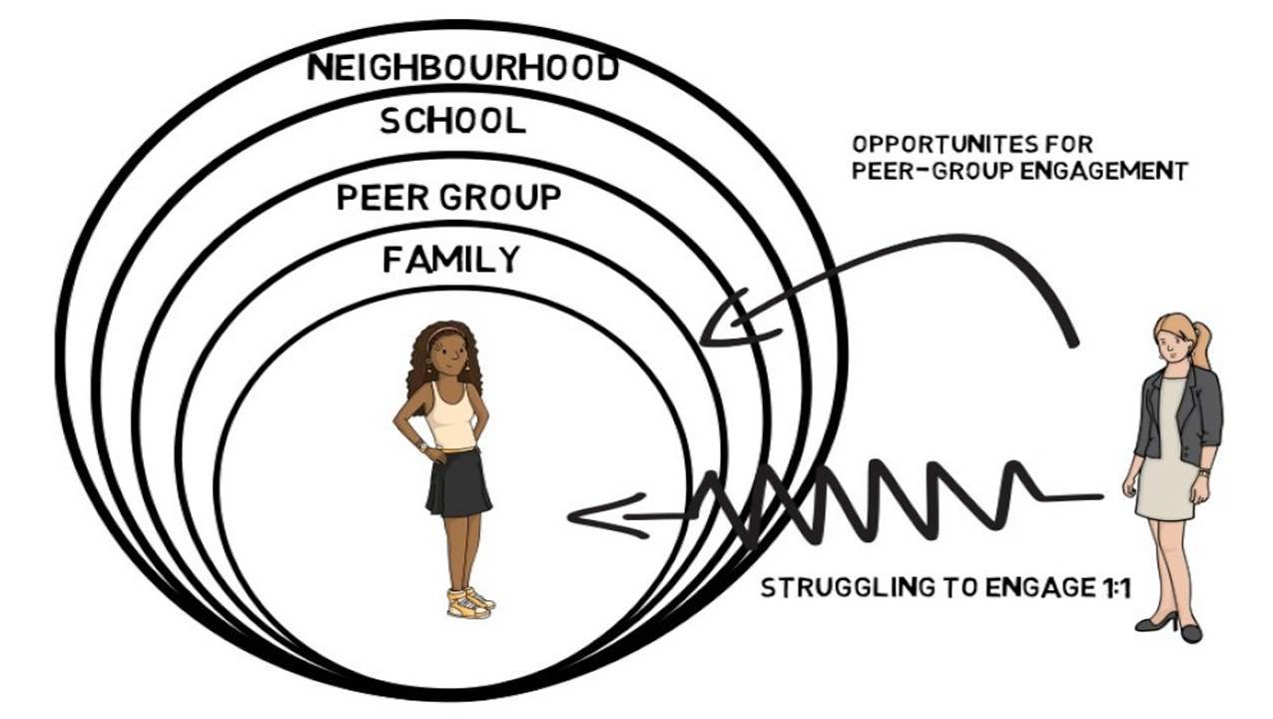
Safeguarding through the Life Course
Keeping communities and ourselves
healthy, happy and safe
Children
Transitional Safeguarding
Contextual Safeguarding
Adults
Safeguarding the environment
https://ncasc.info/wp-content/uploads/2018/11/TW1.pdf
Notes:
Transitional Safeguarding
https://www.basw.co.uk/resources/safeguarding-during-adolescence–-relationship-between-contextual-safeguarding-complex
Contextual Safeguarding
https://ncasc.info/wp-content/uploads/2018/11/TW1.pdf
Safeguarding the Environment
https://www.unido.org/our-focus/safeguarding-environment

Slide 6


Organisational abuse
Caring for the whole system day and night
Neglect and poor care practice as a result of the structure, policies, processes and practices within an organisation.
  within an institution or specific care setting such as a hospital or care home
  care provided in one's own home
  range from one off incidents to on-going ill-treatment
  deliberate
  result of ignorance
  lack of training, knowledge or understanding
  if a person is being abused in one way they are also being abused in other ways
Dr K is a Locum GP who does a home visit at 2am to establish what matters to someone who managed to make a call but who is intermittently confused, confined to their bed, alone at home and living in neglected social housing. This is the third home visit she has done that night. She has already seen 13 people at the base before coming out on visits.
How do we look after and sustain kindness in this GP so that she can remain responsibly curious?
  Other people working at night? Bank staff in care homes? 111?
  Cultures of blame and shame
  Human Factors focus for safety https://uclpartners.com/events/human-factors-training-healthcare-professionals-2/2019-12-20/
  Workforce core needs: Belonging, competency, autonomy https://www.kingsfund.org.uk/blog/2019/03/nhs-crisis-caring
Notes:
https://hackney.gov.uk/contextual-safeguarding
Kindness – https://www.carnegieuktrust.org.uk/publications/kindness-emotions-and-human-relationships-the-blind-spot-in-public-policy/
Learn not Blame - https://www.dauk.org/learnnotblamedauk
https://hackney.gov.uk/safeguarding-vulnerable-adults

Slide 7
What is new in Adult Safeguarding Legislation?
Modern Slavery Act 2015
  Obligation to report
  NB criminal exploitation of children, gangs capitalise on lack of youth facilities to groom children https://www.theguardian.com/society/2020/jan/02/levels-child-criminal-exploitation-almost-back-to-victorian-times
Homelessness Reduction Act 2017
  Obligation to provide care and treatment
  Rough Sleeping Support https://hackney.gov.uk/rough-sleeping
  Safer Surgeries for people without documentation
Domestic Violence Bill 2019 (delayed)
  NB coercive control
  Femicide Census – ‘overkilling’ force used greater than that needed to kill
  https://www.womensaid.org.uk/what-we-do/campaigning-and-influencing/femicide-census/
FGM/FGC Female Genital Cutting* 2019
  Changes to compulsory reporting: genital piercing not need to report
  *When Safeguarding becomes stigmatising https://research-information.bristol.ac.uk/files/187177083/Karlsen_et_al_2019_When_Safeguarding_become_Stigmatising_Final_Report.pdf
Liberty Protection Safeguards to replace DOLs 2020
  Amendment to Mental Capacity Bill which removes people’s rights to information/advocacy before their deprivation of liberty is authorised
  Capacity is still decision specific and best made with professional closest to decision e.g. medication review - GP, housing – social worker
Notes:
When Safeguarding becomes stigmatising https://research-information.bristol.ac.uk/files/187177083/Karlsen_et_al_2019_When_Safeguarding_become_Stigmatising_Final_Report.pdf
https://www.gov.scot/publications/strenghtening-protection-female-genital-mutilation-fgm-analysis-consultation-responses/pages/10/

Slide 8
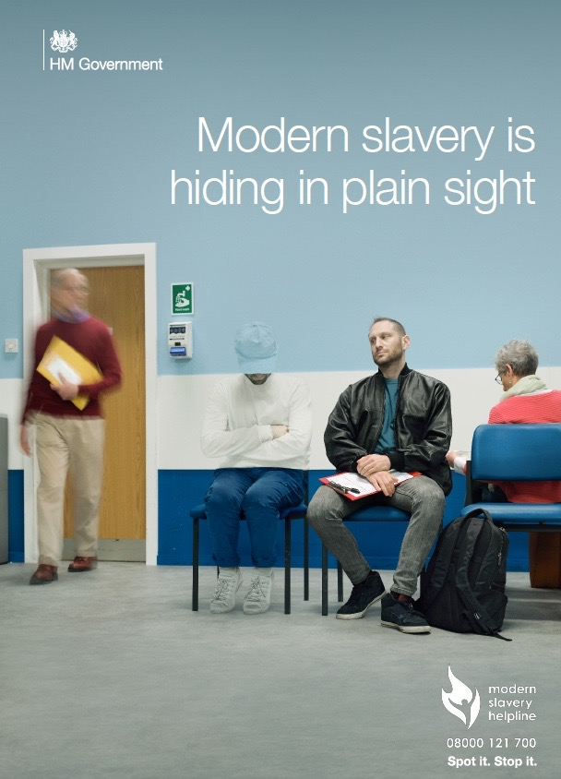
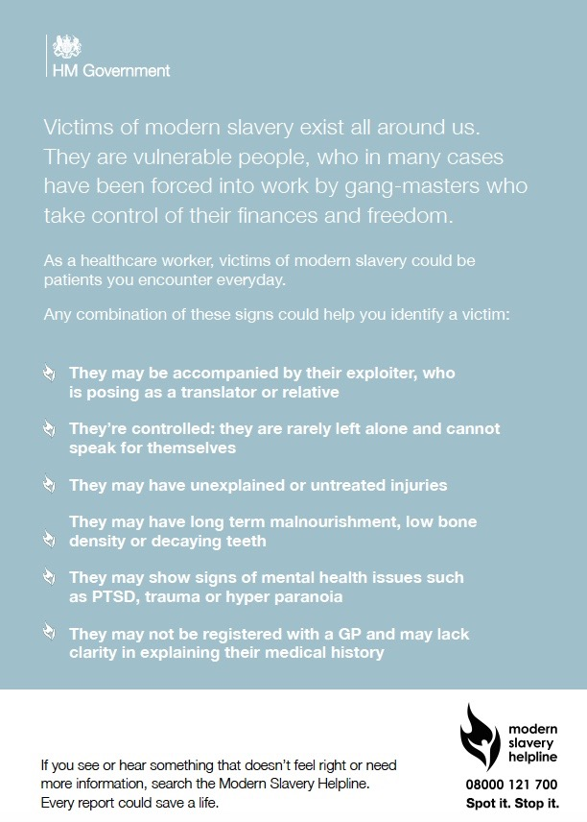
Modern Slavery

Slide 9
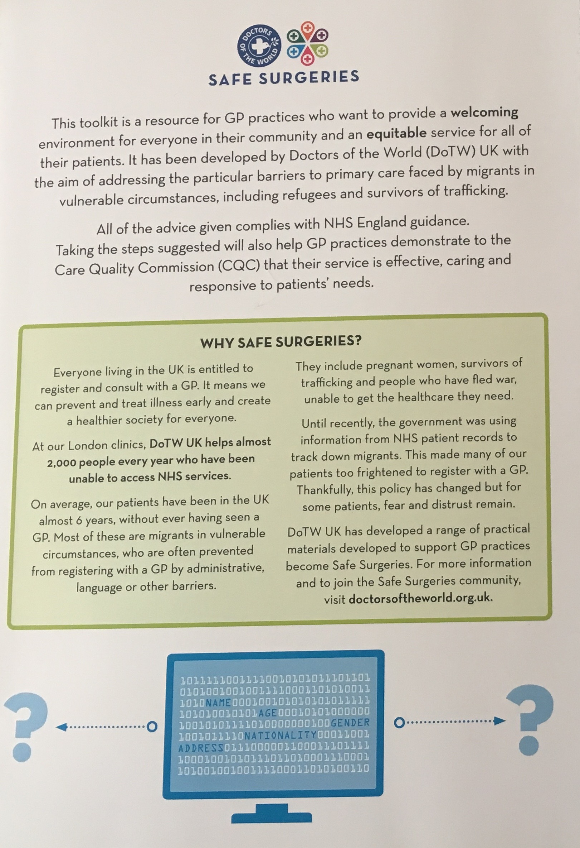
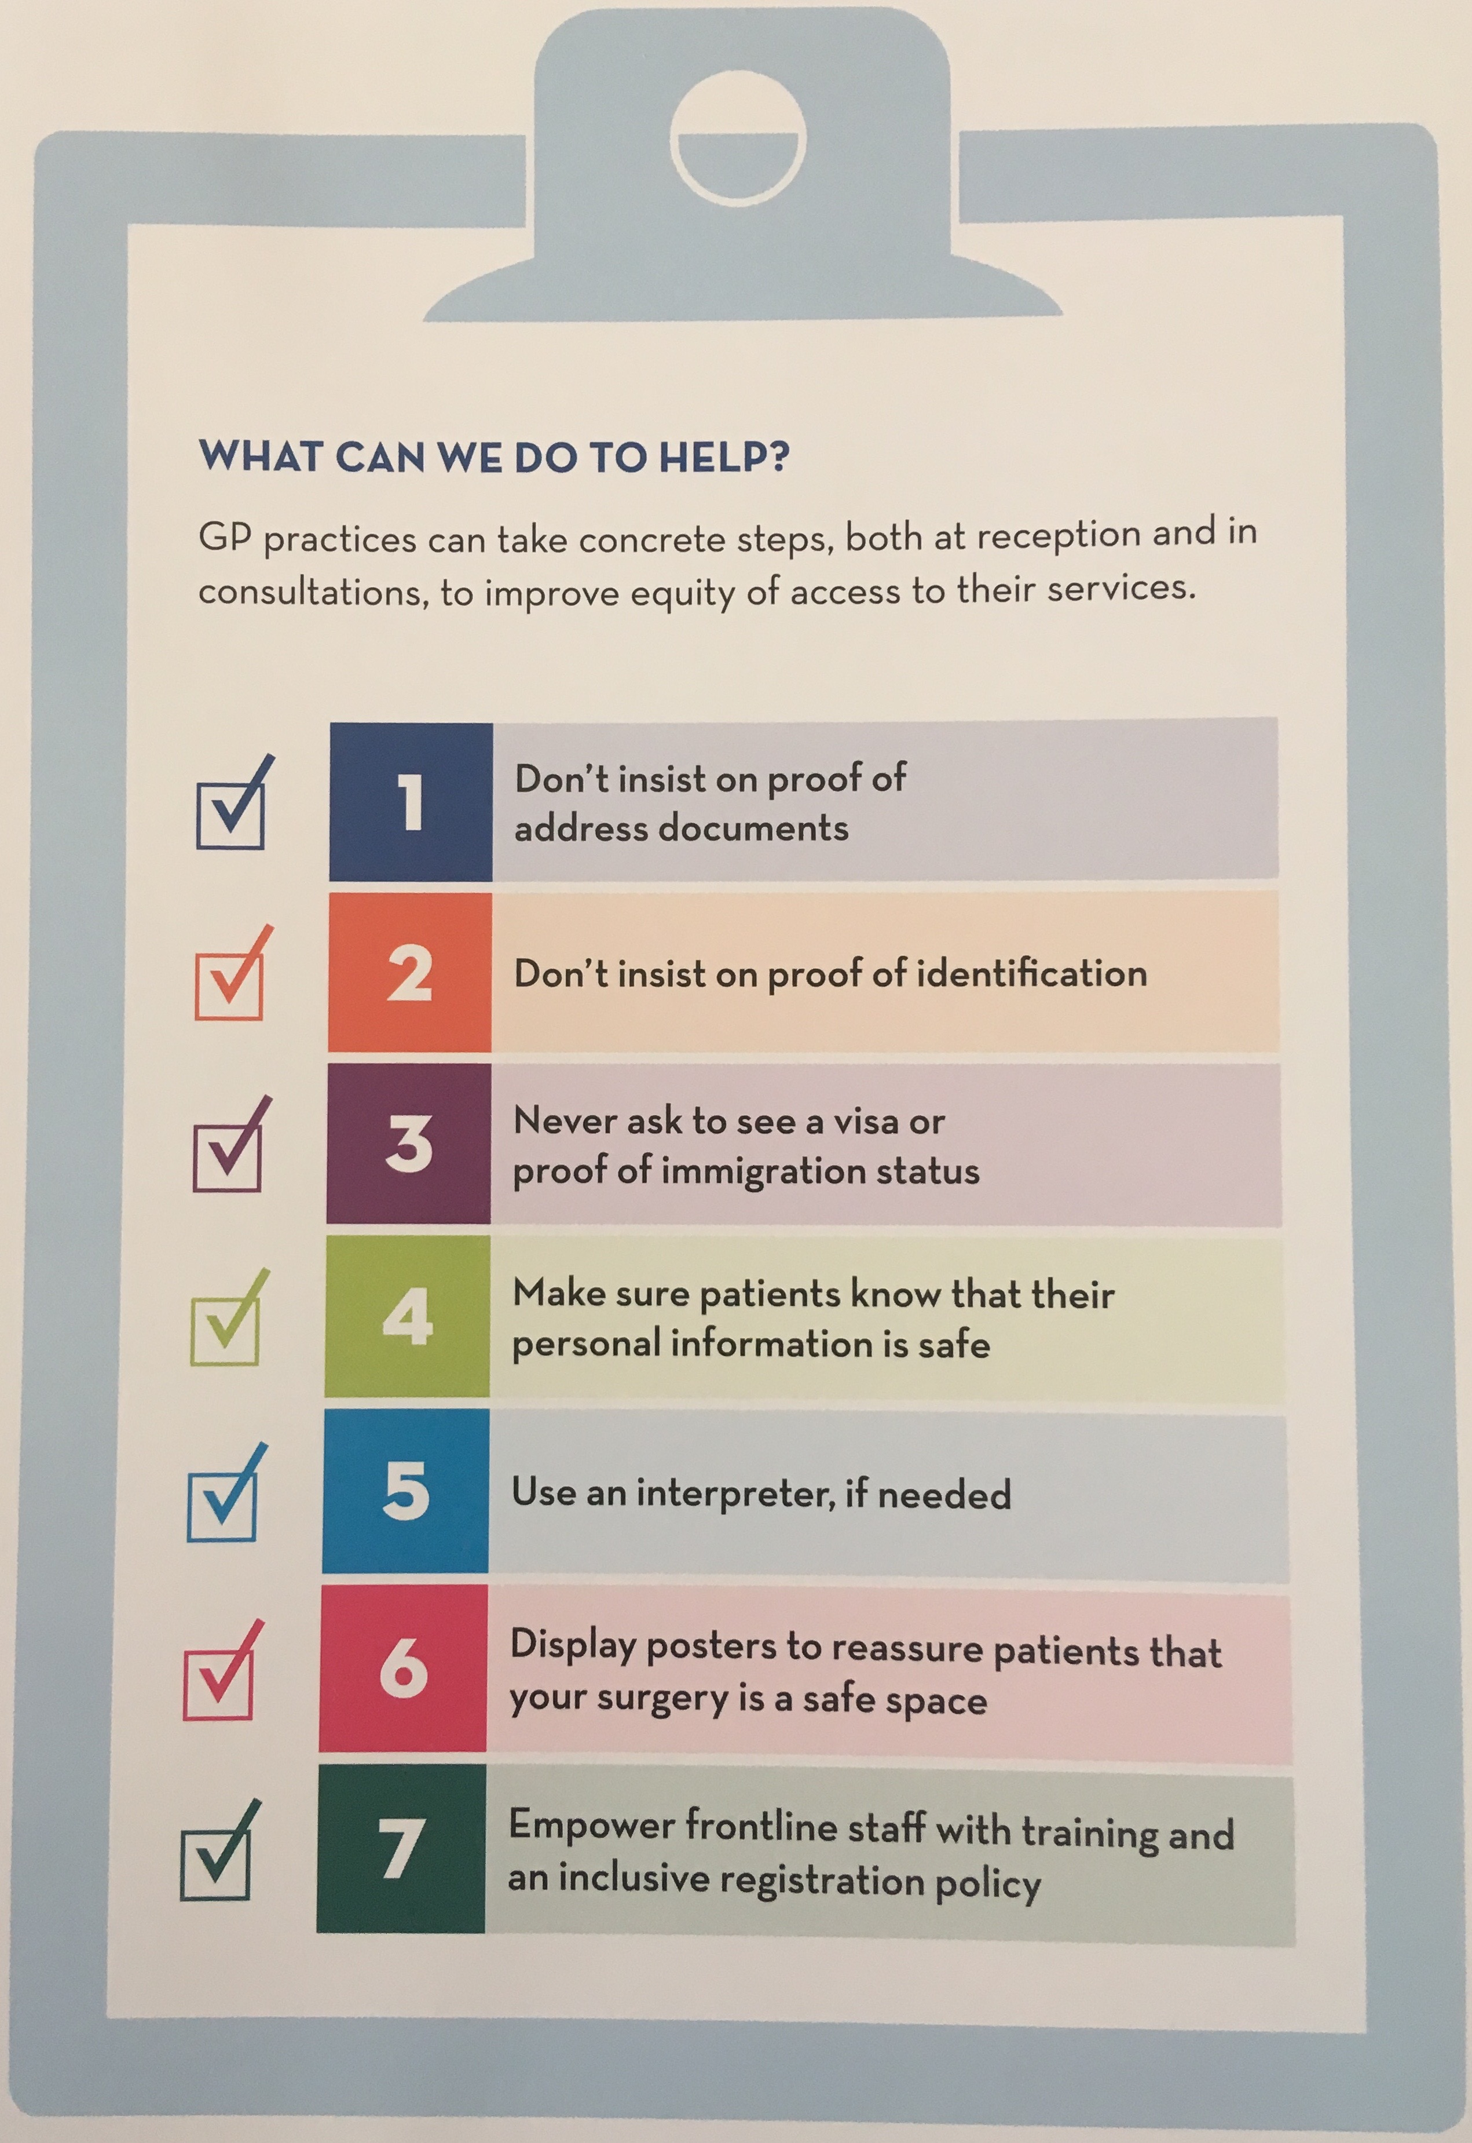
Safe Surgeries
Entitlement to health care for the homeless, refugees and vulnerable migrants in the UK
Notes:
https://gps.cityandhackneyccg.nhs.uk/education/video/doctors-of-the-world-introduction

Slide 10

Banksy Birmingham
https://www.instagram.com/p/B52l1NkHa71/
Notes:
https://www.instagram.com/p/B52l1NkHa71/

Slide 11
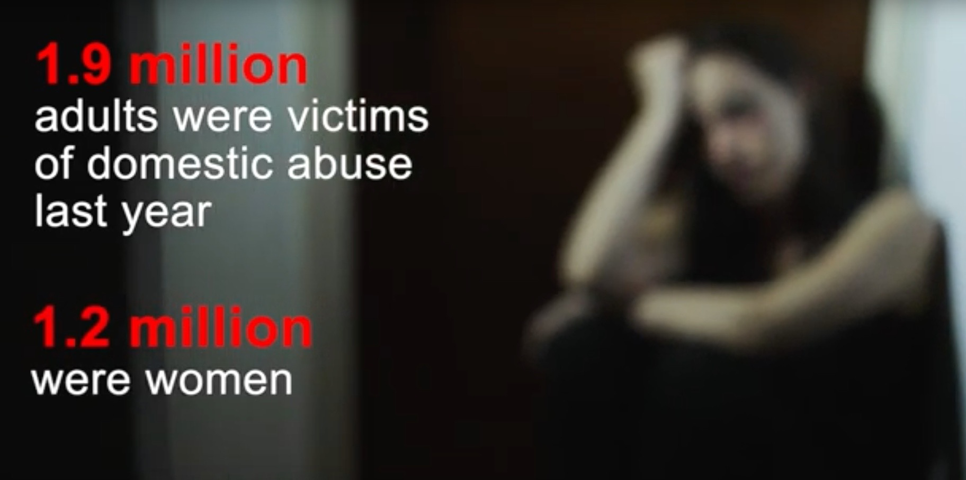
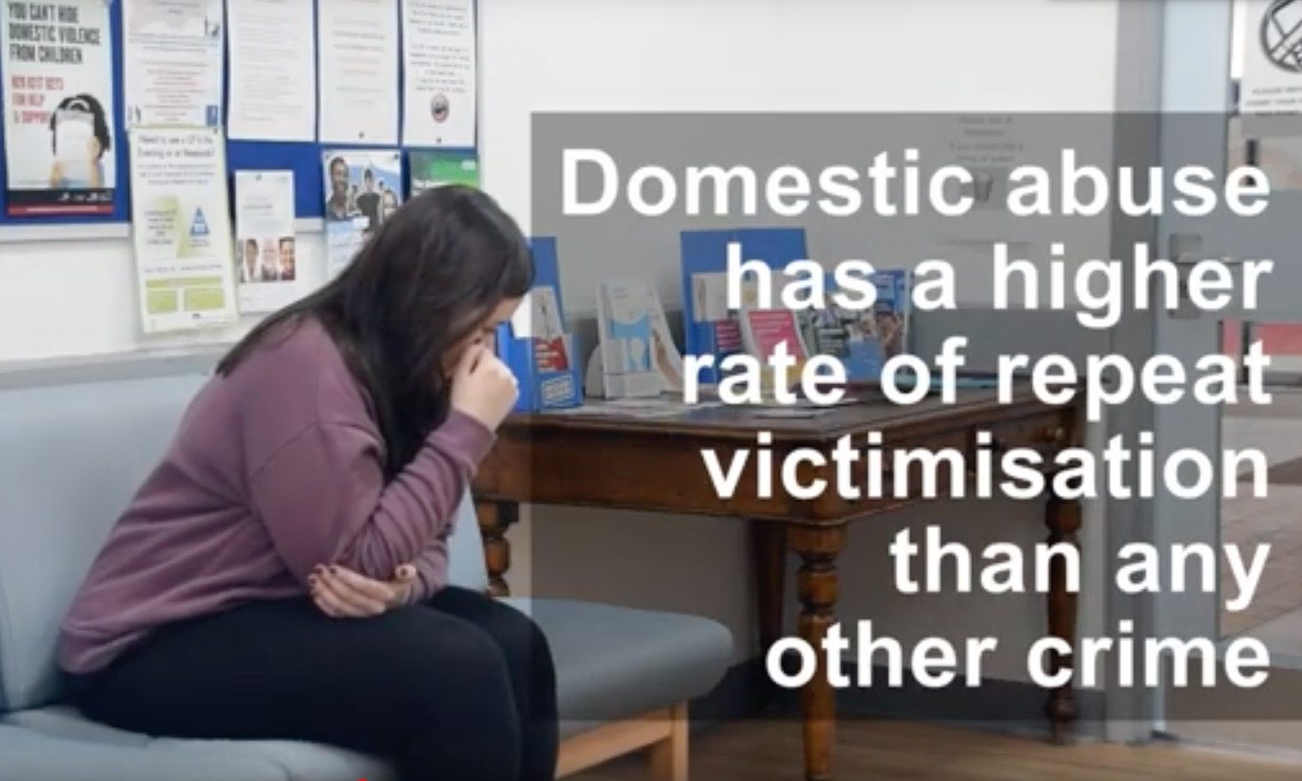
Domestic Violence – Coercive Control
YT Met Police Campaign Domestic Violence https://www.youtube.com/watch?v=9a-9tuDhR0o
Notes:
https://www.youtube.com/watch?time_continue=49&v=9a-9tuDhR0o

Slide 12
What do we know about Adult Safeguarding in C&H?
Data sources:
GP Out of Hours (CHUSHE) Adult Safeguarding Concerns (1.1.2018-31.12.2018)
Safeguarding Adult Reviews (SARs)
Safeguarding Adults Board (CHASB)
Domestic Violence - Police and MARAC
London Ambulance Service Adult Safeguarding concerns in C&H
Mental capacity Audit

Slide 13
1. C&H – GP OOH system at night
GP Out of Hours (CHUSHE) Adult Safeguarding Concerns (1.1.2018-31.12.2018)
Who?
23/53 (43%) >70yrs
15/53 (28%) > 80yrs (NB onset of multi-morbidity occurs 10–15 years earlier in people living in the most deprived areas compared with the most affluent)
  Why?
  - 53 cases included with prompt for safeguarding
    Functional transition (‘frail’ person) mental or physical
    Carer burden (‘frail’ community)
    26/53 (49%) people having both of above

Slide 14
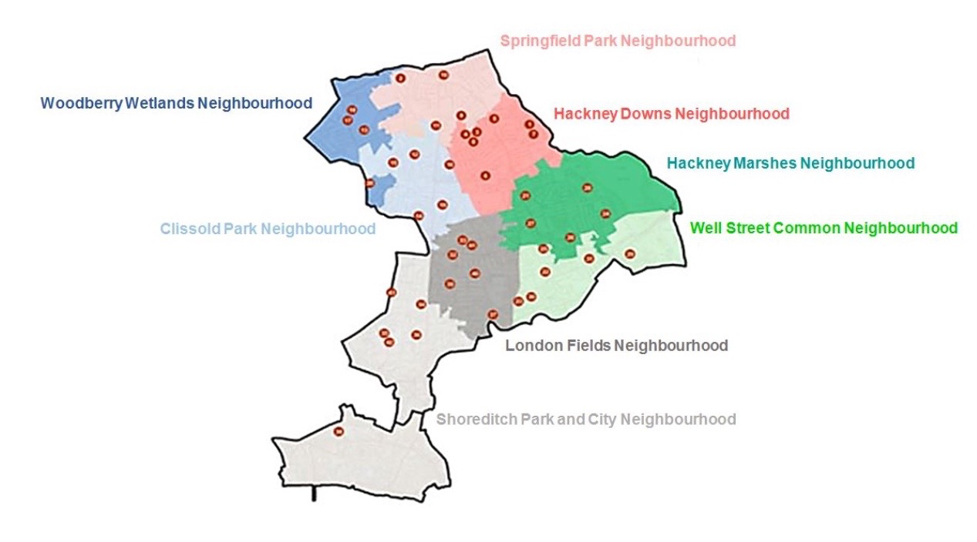
WHERE?
City and Hackney at night by postcode
Notes:
Other data 2019 Cases are identified by practices proactively compared with CHUHSE data which identifies practice blindspot
N16 = 10 [8 cases in Springfield Neighbourhood + 2 Clissold Park Neighbourhood]
E9 = 6 cases reported in Well St Common Neighbourhood
Jan – June 2019 Total number is 33 cases
Approximately reflect the CHUHSE pattern as in areas of pocket deprivation.
https://www.gla.ac.uk/researchinstitutes/healthwellbeing/research/generalpractice/deepend/

Slide 15
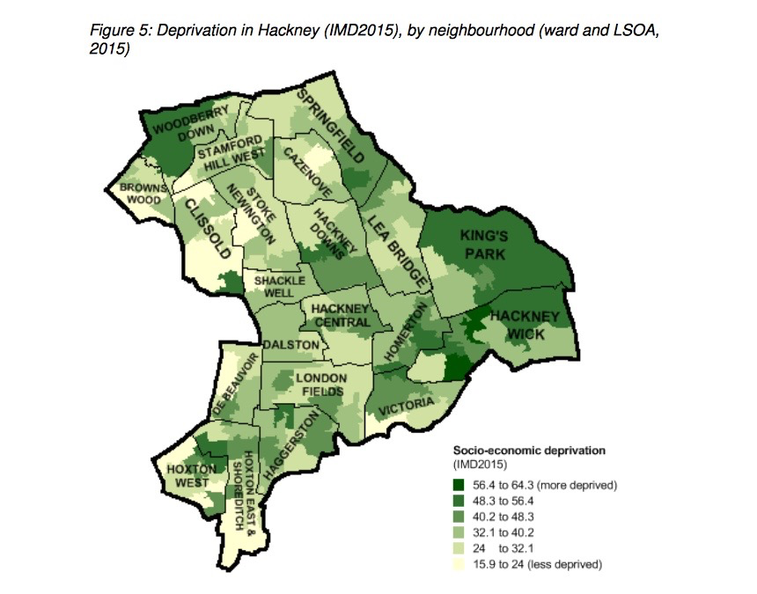
Where?
E5 (14 cases)
E9 (12 cases)
E16 (12 cases)
N1 (6 cases)
N4 (4 cases)
Rest scattered through the borough
https://hackneyjsna.org.uk/wp-content/uploads/2018/05/Living_standards.pdf

Slide 16
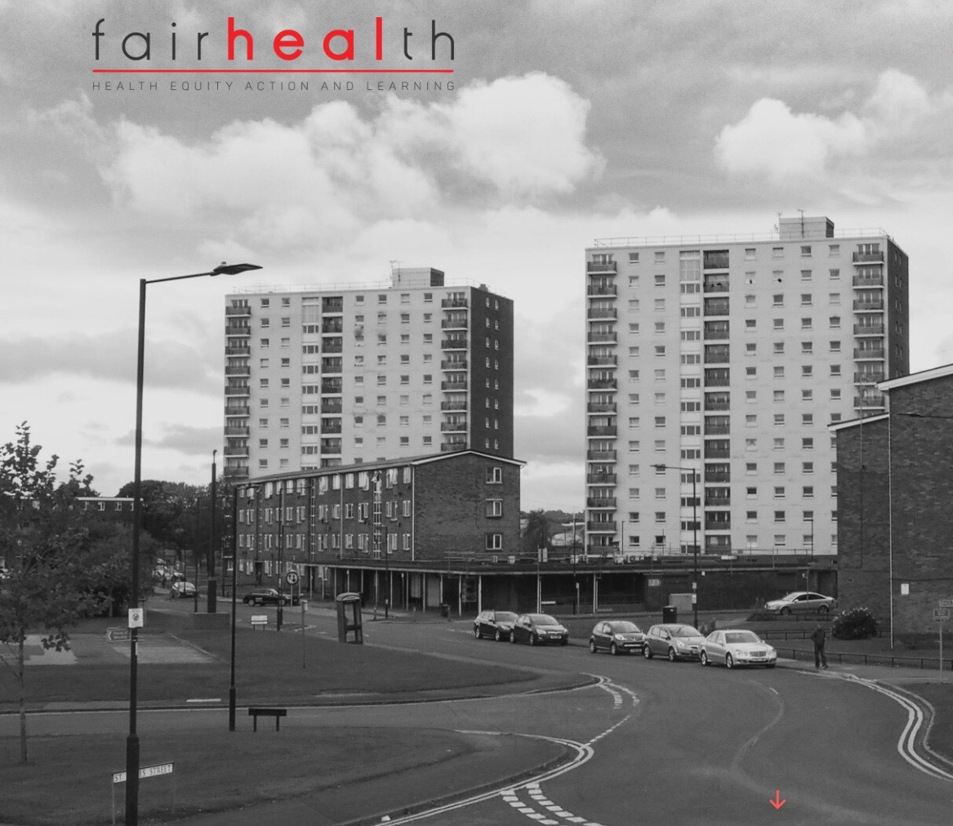

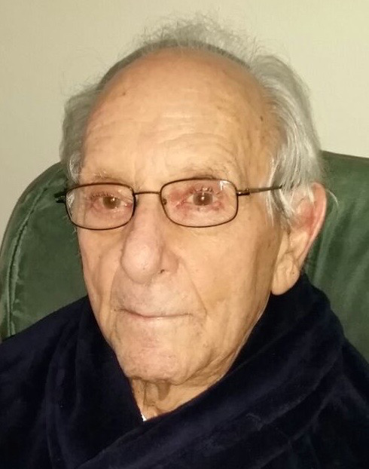
MARMOT REVIEW
https://www.bmj.com/content/364/bmj.l251

Slide 17
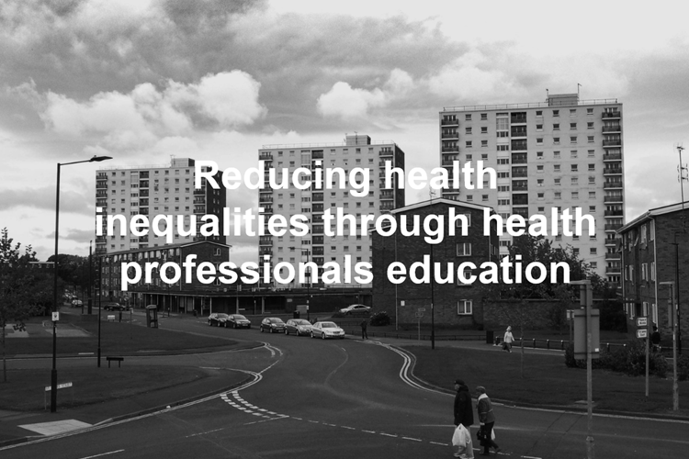


Working in the Deep End
Unworried unwell
Patients with complex problems
  consult more often https://www.bmj.com/content/349/bmj.g6814/rr/808723
  feel less enabled
Doctors feel more stressed after consultations
  https://www.ncbi.nlm.nih.gov/pubmed/18025487
GP at the Deep End ethos is Advocacy, Training, Support and Researchhttps://www.gla.ac.uk/researchinstitutes/healthwellbeing/research/generalpractice/deepend/
https://www.fairhealth.org.uk

Slide 18
2. Safeguarding Adult Reviews (SARs)
Safeguarding Adult Reviews (SARs) identified professional learning needs in:
  Ability to assess capacity
  Recognising carer burden
  Understanding functional trajectories in particular people confined to their chair or bed
  Risks associated with multiple contacts and with multiple agencies especially handovers within and outside the practice
  Identifying quality improvement initiatives for system change
    within GP Practices
    broader system

Slide 19
3. Data C&H Safeguarding Adults Board
Annual Report 2016/17
  32 concerns raised (Section 42)
  22 led to Section 42 Enquiry
  Themes included:
    Neglect (N=12)
    Financial (N=6)
    Physical (N=4)
    Self neglect (N=3)
    Domestic (N=2)
    Multiple (N=5)
Notes:
Bohemian Polypharmacy https://www.youtube.com/watch?v=Lp3pFjKoZl8
Make it Easy https://www.youtube.com/watch?v=b18EWaTevu4
Choosing Wisely UK https://www.choosingwisely.co.uk/about-choosing-wisely-uk/

Slide 20
4. Data C&H LAS
  LAS Data provisional data
  Safety / Autonomy
Neglect
  Unintentional – carer burden
  Loneliness – understanding value of social capital
  Hoarding
    Whose problem is this? Family? GP? Social Care?
    Capacity based approach (Understand/Retain/Weigh up/Communicate)
    Practical consider fire service if fire risk

Slide 21
5. Data C&H Domestic Violence
National Data
  Research show average 35 assaults before ending a relationship https://www.refuge.org.uk/our-work/forms-of-violence-and-abuse/domestic-violence/domestic-violence-the-facts/
  Risk of harm to the victim is highest at the point of leaving the relationship and for up to two years afterwards
  Average of two deaths per week are domestic violence related
  Femicide Census – ‘overkilling’ - force used greater than that needed to kill https://www.womensaid.org.uk/what-we-do/campaigning-and-influencing/femicide-census/
Local Data from Hackney Police
  60/40 split in terms of victims female:male respectively
  400 offences per month noted by police - July spike most years – 500
  NB also intra-familial e.g. not an intimate relationship but for example between siblings; adult child violence on parent
.
Notes:
Tired all the time, sleep, low mood. Discussion about handover in practices, parents and children seen by same GP – named GPs. Are family notes linked? You may be doing this already – handovers? DNA alerts for children,

Slide 22
6. Data C&H MCA Audit
Mental Capacity Audit 2018 identified Professional learning needs in:
  Considering capacity in relation to a new decision
  Enabling positive risk taking especially Medication Review
Notes:
Bohemian Polypharmacy https://www.youtube.com/watch?v=Lp3pFjKoZl8
Make it Easy https://www.youtube.com/watch?v=b18EWaTevu4
Choosing Wisely UK https://www.choosingwisely.co.uk/about-choosing-wisely-uk/

Slide 23
Mr R is on 11 medications
Every decision about my medication, with me
Capacity is decision specific:
Can Mr R – understand? retain? weigh up? communicate?
Mini- cog https://mini-cog.com/graphical-mini-cog/
Who is the professional best placed to facilitate the decision regarding his medications?
If Mr R has impaired capacity then who else needs to be involved?
Advocacy?
Best interest , least restrictive option
Handy Approach to Care
Longitudinal Investigation of Older Adults' Ability to Self‐Manage Complex Drug Regimens https://onlinelibrary.wiley.com/doi/abs/10.1111/jgs.16255
Notes:
Longitudinal Investigation of Older Adults' Ability to Self‐Manage Complex Drug Regimens
https://onlinelibrary.wiley.com/doi/abs/10.1111/jgs.16255

Slide 24

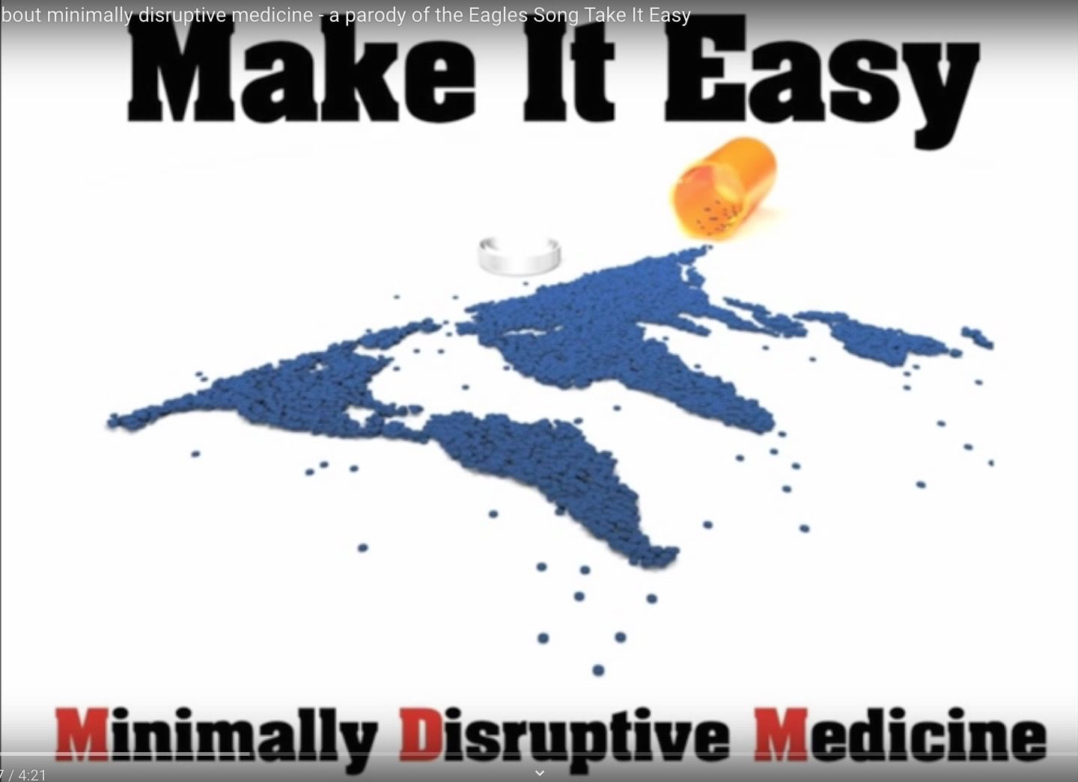

Every decision about my medication, with me
Bohemian Polypharmacy https://www.youtube.com/watch?v=Lp3pFjKoZl8
Make it Easy https://www.youtube.com/watch?v=b18EWaTevu4
Choosing Wisely UK https://www.choosingwisely.co.uk/about-choosing-wisely-uk/
Notes:
Bohemian Polypharmacy https://www.youtube.com/watch?v=Lp3pFjKoZl8
Make it Easy https://www.youtube.com/watch?v=b18EWaTevu4
Choosing Wisely UK https://www.choosingwisely.co.uk/about-choosing-wisely-uk/

Slide 25
Ms F’s story Sept 2017
Narrative adapted from City and Hackney Safeguarding Adults Board Safeguarding Adults Review
https://drive.google.com/file/d/1IuE9kuHvDED9Tx0S-2hpyweRwd9D92FP/view
‘I am 44 years old and have lived in Hackney all my life. I was diagnosed with Multiple Sclerosis 10 years ago, which has now affected my ability to communicate fluently, and I need support to express my decisions and for every other aspect of my life including being helped to eat and drink. I feel like a spectator in my life starting but nor completing things that are important to me.
I have two carers, who change a lot so I don’t know them but who help me four times a day. They are always in a rush to their next client. I live with my son who has cerebral palsy and who has his own live-in carer. My adult daughter has been a carer herself since the age of 7years and she is trying to complete her college course despite her own mental health issues.
I don’t want to be a burden and I am so thankful for all the care I get that I did not want to make a fuss when my mattress started to deflate on 4 September. My daughter tried to inflate the mattress unsuccessfully and wasn’t sure who to contact because the contact details on the mattress had faded.
I told the carers that I had been uncomfortable overnight and that I was in pain. Over the next four days my carers cared for me on my deflated mattress. The mattress company came on 8 Sept and noticed that I had developed a large pressure ulcer and contacted my GP who contacted the district nurse. There must have been some confusion as the district nurse only came on the 10 Sept. My pressure ulcer was dressed daily until 14 Sept when I was admitted to hospital as the pressure ulcer had reached my bone and was infected. I was treated in hospital until 30 September.
I was in a lot of pain but did not want to make a fuss. It must not happen again. God, no!’
Notes:
Recognition of functional transitions and risk of pressure ulcers i.e. when shifting from being mobile to becoming sedentary and from being sedentary to being confined to bed. Pressure ulcers impact significantly on quality of life
Pressure ulcers in sub-dermal tissues under bony prominences very likely occur between the first hour and 4 to 6 hours after sustained loading. Mainly on the sacrum and heels in patients lying in a supine position
Incidence of ulcers markedly increases the longer the patient is sitting or lying down. Some individuals can tolerate sustained tissue loading better than others due to anatomical differences, variations in the mechanical characteristics of tissues, perfusion quality, general health status, the posture sustained, and perhaps interactions of these factors with the biomechanical performances of the specific support surface used.
Pain, exudate and odour compromise patient functioning so need systematic and regular pain assessment
How much time does it take to get a pressure ulcer? 2008 Wound management and Prevention https://www.o-wm.com/content/how-much-time-does-it-take-get-a-pressure-ulcer-integrated-evidence-human-animal-and-in-vitr
New Guidance on how to define and measure pressure ulcers 2018 Nursing Times https://www.nursingtimes.net/clinical-archive/tissue-viability/new-guidance-on-how-to-define-and-measure-pressure-ulcers/7025908.article
A patient-reported pressure ulcer health-related quality of life instrument for use in prevention trials (PU-QOL-P): psychometric evaluation 2018 Health and Quality of Life Outcomes https://hqlo.biomedcentral.com/articles/10.1186/s12955-018-1049-x

Slide 26
JoJo’s story as told by her mother
Narrative adapted from City and Hackney Safeguarding Adults Board Safeguarding Adults Review
https://drive.google.com/file/d/1nvlp1tDuFNl5v5ykmV7YXMep90TQUh6Y/view
‘ I am the mother of JoJo, who was born with Downs Syndrome 38 years ago. I was her main carer through out her life helping her through school into adulthood. Jo-Jo needed help with many daily living tasks including personal care, eating the right things, managing money and personal relationships. Jo-Jo really liked music and TV. She had enjoyed school and loved her family. Her two younger sisters and I all had a strong bond with her and she was loved as an equal part of the family and involved in activities.
Since childhood Jo-Jo had suffered from eczema, which often caused her distress and discomfort. It would sometimes get better but then it would come back again. I was the one who applied the creams every day.
In 2013 I was told that Jo-Jo had something called crusted scabies also called Norwegian Scabies, which seemed to go away. In 2015 Jo-Jo’s skin problems came back and she was seen at the hospital where they said it was eczema and to continue to treat it as eczema, though the GPs did question if this was correct.
The local authority provided services for 6 hours a week to support Jo-Jo to go out twice a week. The purpose of this was to give Jo-Jo an opportunity to go out for a coffee or to the shops. She liked going to the shops at Stratford.
There were many times when Jo-Jo did not want to go out because her skin condition was so bad and people looked at her, many times she could not go out because the scabs and infection on her feet made it too painful to walk and I had to cancel the services arranged for Jo-Jo. She did go into respite care for 2 weeks in August 2016 but her skin condition became very bad in December 2016 and I found it very difficult to apply any of the medication and creams because it hurt her too much. Jo-Jo often tried to stop me from trying to treat her, which made my life very difficult.
District Nurses did visit in January 2017 and told me that I should continue to apply the medication even though Jo-Jo was in a lot of pain, but they did not offer a follow up appointment.
On 9th March 2017 I called the GP to see Jo-Jo at home as she was lying on the floor, not able to stand and her skin condition was very bad. The GP explained that we had two choices at that time: one was to get Jo-Jo to hospital immediately through A&E which would have involved a lot of hanging about and Jo-Jo might then have been sent home. The second option was to get Jo-Jo seen urgently by a skin specialist the next morning. The GP felt the second option was more likely to support Jo-Jo in a clear diagnosis especially if she had reinfection with Norwegian Scabies. The GP spoke to the consultant doctor and made an emergency appointment for the next day. The ambulance came as arranged and took Jo-Jo to the hospital clinic where she suffered a cardiac arrest and sadly died that morning’

Slide 27

Appreciative Inquiry Mindset
Resourceful (Frail) Person? Strong (Frail) community? Resilient (Frail) System?
POSITIVE CORE
Inquire into what works
Imagine how good it could be
Engage the team and agree how good it could be
Commit to what it will be and identify first steps to bring you closer
What is already working and how can we build on that?
Resourceful Person:
  How was Ms F/ Jo Jo and her family empowered in shaping her care?
Strong Community:
  Who is looking after the carers?
Resilient System:
  How kind was the system to the people who delivered care to Ms F/ Jo Jo?
Appreciative Inquiry Resources https://www.evidence.nhs.uk/search?q=appreciative+inquiry
Notes:
Appreciative Inquiry Resources https://www.evidence.nhs.uk/search?q=appreciative+inquiry
Suzette Woodward Rethinking Patient Safety
Carolyn Canfield: A Safety-II Perspective on Organisational Learning in Healthcare Organisations Comment on "False Dawns and New Horizons in Patient Safety Research and Practice
https://www.ncbi.nlm.nih.gov/pmc/articles/PMC6037496/

Slide 28
A home visit - 1
You are a GP Locum and asked to do a home visit to Mrs S who has had a fall and has shoulder pain
Referral made by Speech and Language Therapist [SLT]
You check the notes and you see that Mrs S cannot communicate without the aid of the Speech and Language Therapist [SLT] as she has Motor Neurone Disease
You have never met Mrs S before this time
She has a named GP, that GP is not in and the last four visits have been done by 4 different GPs none of whom are on site
You are unable to get hold of the SLT before the visit

Slide 29
A home visit - 2
History from Husband Mr S present says pain and bruising left shoulder since fall 4/7 ago, he was upstairs and heard her fall, found her on left side, since fall not been able to use left hand to feed herself. Hadn’t noticed bruising until mentioned by SLT
Mrs S is according to her husband
Cognitively impaired past 4 years BUT able to communicate wishes with aid of SLT
Functionally very limited, chair dependent, transitions with aid but sometimes able mobilise occasionally on own
Lives with him - stair lift in place past few days and recent move from microenvironment on ground floor upstairs now shares room with husband. He is responsible for all her care and care of the house. He tells you, he has had his own recent possible serious diagnosis. Note he is not registered at the same practice as his wife
On a good day according to her husband she will be more responsive and cries less, enjoys having grandchildren around
Consent through husband to examine Mrs S
You examine her and you note bruising over the left clavicle

Slide 30
Coproducing care in difficult circumstances
I am Hungry Angry Late Tired
I don’t know the person or their family
Acute on Chronic confusion
Self doubt
I don’t know what is
going on here?
I will upset the family
Difficult to examine in their setting
Admission avoidance
Unwell and Alone at night
Carer seems to know best
Confined to bed and dependent on someone who is cognitively impaired
I don’t know what to do next
Person has limited English and no interpreter

Slide 31
A home visit - 3
Need for x-ray was discussed with husband as uncertainty of diagnosis
Mr S explained multiple barriers why he was not able to take Mrs S for an x- ray that afternoon
Locum GP left with plan for analgesia and to review in 48 hours when he would be back at practice as no clear handover plans were in place at the practice
Locum GP on reflection was unhappy with plan and following morning called and spoke to duty doctor that patient needed to go into A/E for review and not wait
Duty Doctor said that they didn’t know patient or family and best for Locum GP to call Mr S and let him know change of plan
Locum GP called and encouraged Mr S to take Mrs S to A/E
X-ray showed fractured clavicle
Mrs S was admitted as carer burden was recognised
Mrs S was moved to supported accommodation where she now lives
Mr S diagnosed with lung cancer and died a few months after this event

Slide 32
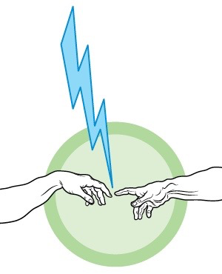
Handing over early recognition of vulnerability amongst the ‘frail’
Shared Decisions
Handy Approach to Care
Sparrow

Slide 33
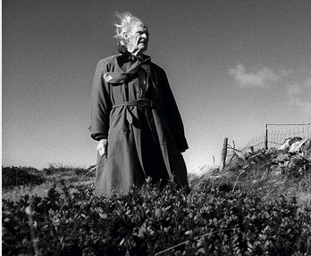
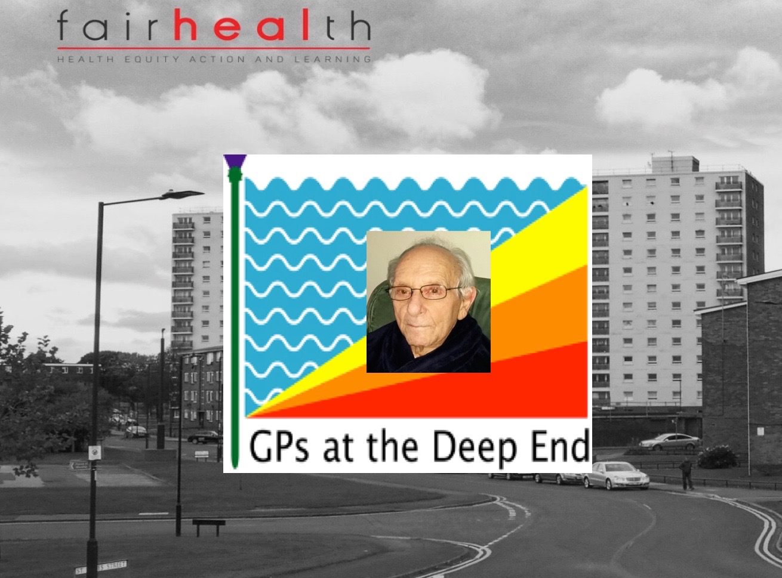
Subjective – Objective
Frail person?
Frail community?
Frail system?
RS THOMAS at his home on the LLYN PENINSULA September 1997 *
Living well at the End of Life. Adapting Health Care to serious chronic illness in old Age (RAND 2003) [1]
The End of the Disease Era (Am J Med 2004) [2]
Medical care for the final years of life: "When you're 83, it's not going to be 20 years” (JAMA 2009) [3]
Epidemiology of multimorbidity and implications for health care, research, and medical education (Lancet 2012) Onset of multimorbidity occurred 10–15 years earlier in people living in the most deprived areas compared with the most affluent [4]
‘I told you I was ill’
SPIKE MILLIGAN
* https://howardbarlow.photoshelter.com
Notes:
[1] Living well at the End of Life. Adapting Health Care to serious chronic illness in old Age (RAND 2003) https://www.rand.org/pubs/white_papers/WP137.html
[2] The End of the Disease Era (Am J Med 2004) https://www.ncbi.nlm.nih.gov/pubmed/14749162
[3] Medical care for the final years of life: "When you're 83, it's not going to be 20 years” (JAMA 2009) https://www.ncbi.nlm.nih.gov/pubmed/20040557
[4] Epidemiology of multimorbidity and implications for health care, research, and medical education (Lancet 2012) https://www.thelancet.com/journals/lancet/article/PIIS0140-6736(12)60240-2/fulltext

Slide 34

How do we manage uncertainty?
C
O
N
S
E
N
T
Every decision about me, with me

Slide 35
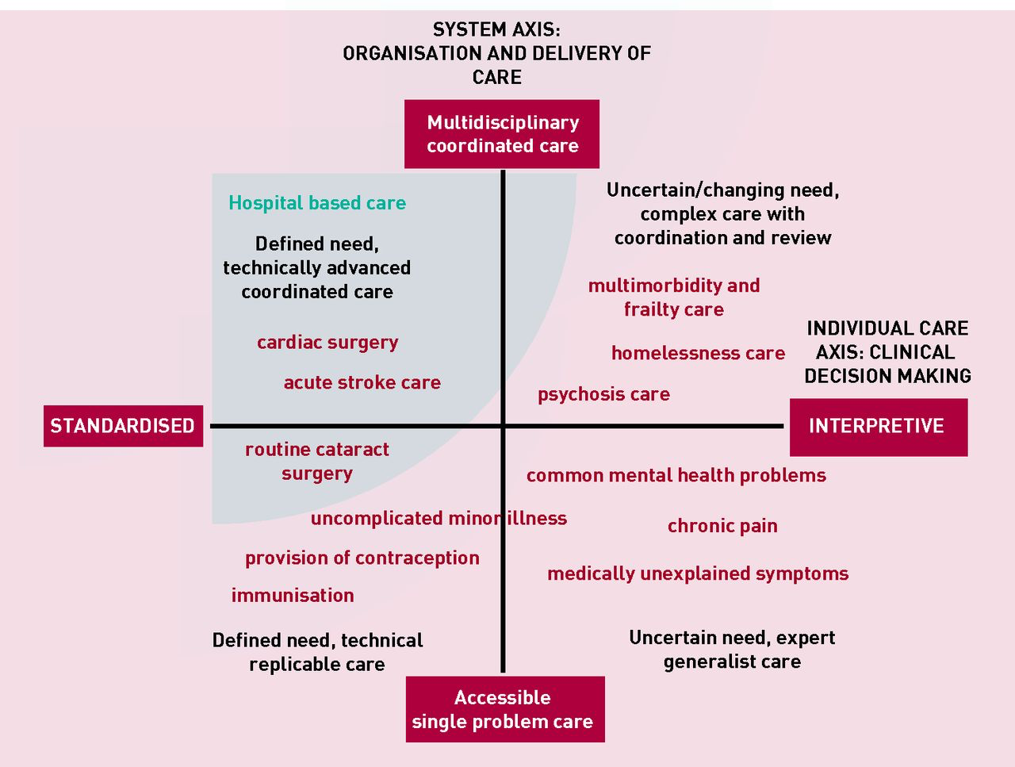
Managing Uncertainty and Coproduction of Care
Realising the full potential of primary care:
uniting the ‘two faces’ of generalism. BJGP 2017
Joanne Reeve and Richard Byng
Notes:
Realising the full potential of primary care: uniting the ‘two faces’ of generalism BJGP 2017
Joanne Reeve and Richard Byng
http://bjgp.org/content/bjgp/67/660/292.full.pdf
The ‘Systems Axis’ (on the Y axis) describes a continuum from single problem accessible care through to integrated coordinated care bringing different skills and TEAMS together.
The ‘Individual Care Axis’ (on the X axis) recognises a continuum from standardised, replicable and often evidence informed, to highly-individualised interpretative care. This axis recognises that standardised disease-focused (guideline) medical care, even done well, can have a burdensome effect on individuals. Burden comes in many forms; whether as over-investigation and over-treatment, or as a failure to adequately address illness experiences that disrupt daily living (a failure of person-centred care). The two models at each end of the axis represent distinct forms of clinical reasoning that ask different questions and are underpinned by different epistemological approaches. In reality, primary care clinicians are often required to move along the continuum in response to particular patient needs.
We thus describe four quadrants with distinct categories of care provision . ‘Single problem/standardised care’ delivers low intensity accessible care at volume, mainly but not only in primary care; and increasingly achieved through technology- supported self-care (for example, blood pressure monitoring, contraception advice) and deployment of less highly-qualified staff (for example, fractures, minor illness). ‘Integrated/standardised care’ sees well- coordinated teams providing access to, and delivery of, condition-specific treatment whether acute management of myocardial infarction or surgical replacement of joints or valves. In both cases, interpretive skills are a lower priority.
Some patients, for example those with mild to moderate mental health needs or medically unexplained chronic pain need ready access to professionals skilled in interpretive practice. Professionals who are able to integrate biomedical, psychosocial, patient and professional accounts of illness in order to help patients make sense of, and so take an active part in managing, their own health problems. Patients in this ‘Accessible/Interpretive’ quadrant may benefit from signposting to services outside of medical care, but generally don’t need high levels of integrated care across medical teams. Some need ongoing continuity of care, while for others a single contact can provide timely treatment, reassurance or diversion from unnecessary investigation or medicine.
Patients with chronic complex care needs, especially those with diminished capacity to manage daily living (for example, multimorbidity, severe mental illness, homelessness), need both coordinated/ integrated and interpretive care. Medicine in this quadrant requires expert practitioners able to make decisions with patients, and work across teams taking account of shifting needs in the social, emotional, and biological domains. This approach should help prioritise needs and support choices to do less medicine, so avoiding the iatrogenic harm arising from a failure to tailor care to the individual-in-context.

Slide 36

What is the Handy Approach to Care?
Integrated Framework for professionals to formulate and safe handover care (tested in Newham Community Health Services) [1]
Balances narratives of dignity and safety Ideal for handovers [2]
Combines all domains of care:
  Mental
  Physical
  Social
  Personal
Safe: Three Safeguarding Alerts (mental, physical, social)
Easy to learn and to remember - mapped on the hand (tested Tower Hamlets Community Health Services) [3]
Quick to use
Person-centred: Captures baseline through an impression of the lived life of person receiving care
Concise summary using five questions
Notes:
[1] The Handy Approach – Quick Integrated Person Centred Support Preparation BMJ Risi L, et al. 2017;6:u214461.w5681. doi:10.1136/bmjquality.u214461.w5681 https://bmjopenquality.bmj.com/content/bmjqir/6/1/u214461.w5681.full.pdf
[2] Dynamics of Dignity and Safety Goodwin D,Mesman J, Verkerk M, et al.BMJ Qual https://qualitysafety.bmj.com/content/27/6/488
[2[3] Learning the Handy Approach to Care in time limited environments https://qi.elft.nhs.uk/wp-content/uploads/2018/06/Poster-A-HANDY-APPROACH-QUICK-WAYS-OF-LEARNING-IN-TIME-LIMITED-ENVIRONMENTS-_.pdf

Slide 37
The Handy Approach to Care
Safe, Quick, Person Centred
Thumb/Cognition: Is Jean able to remember what she did yesterday? *
Index finger/Consent: Does Jean give us permission to be involved in her care?
Middle finger /Function: Is Jean able to get out of bed?*
Ring finger /Setting: Is Jean alone at night or living with someone with impaired cognition?*
Little finger/Hopes: What matters to Jean when she is having a good day? How does Jean get through her day?
* Safeguarding Alerts

Slide 38
Safeguarding Alerts
Any cognitive impairment (cognition)
  Acute e.g. delirium
  Acute on chronic: e.g. delirium in a person with dementia
  Chronic e.g. person with dementia
Confined to bed/chair (function)
Alone at night or lives with person with impaired cognition (setting)
If a person has all of the above, then then they will be additionally vulnerable and will need resource intensive support with attention to safeguarding their rights.
Notes:
Resources Handy Approach to Care

Slide 39
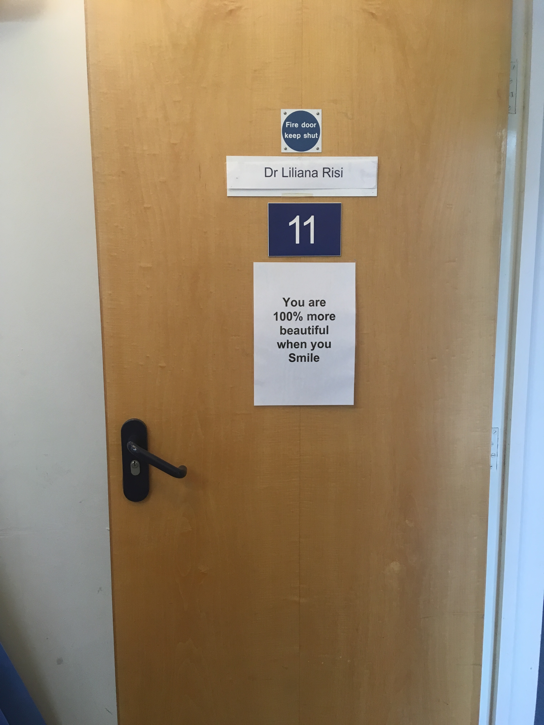
Thank you

