Slide 1
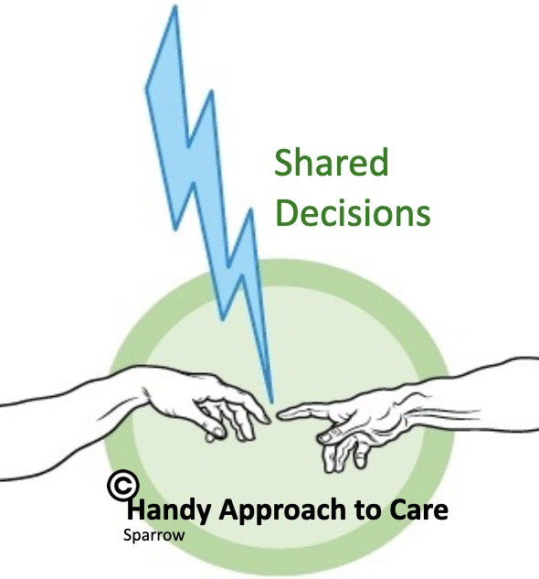
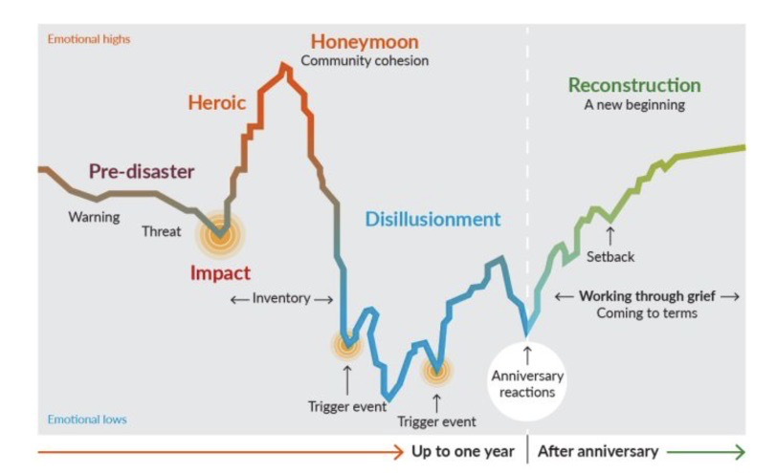

Moving from
time poor to time rich
through micro-GP teams in large practices
with a part-time GP workforce
Dr Liliana Risi
GP Webinar for NCL Practices Thursday 10 March 2022
LRISI@nhs.net
https://handyapproachtocare.com

Slide 2
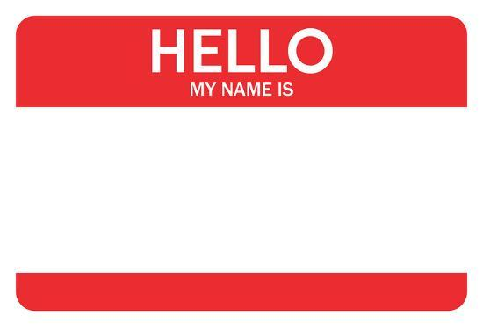
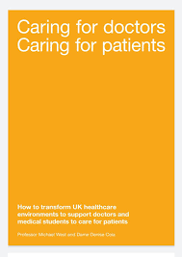
Bringing our whole self to work
Autonomy
Belonging
Competency
Lili
Notes:
GMC Caring for doctors. Caring for patients https://www.gmc-uk.org/-/media/documents/caring-for-doctors-caring-for-patients_pdf-80706341.pdf
If we want change to happen we need to start with ourselves (Gandhi)
Acknowledge yourself for the hard work that you do daily
Remind yourself that you are ‘purposeful, thinking, feeling, emotional, reflective, relational and responsive’ http://bjgp.org/content/bjgp/66/652/582.full.pdf
‘relationships will be the foundation of healthcare’s new age’ ( Berwick: 9 steps to the Moral Era) http://www.ihi.org/about/news/Pages/ChronicleofHealthCreation.aspx
Abandon unhealthy perfectionism

Slide 3
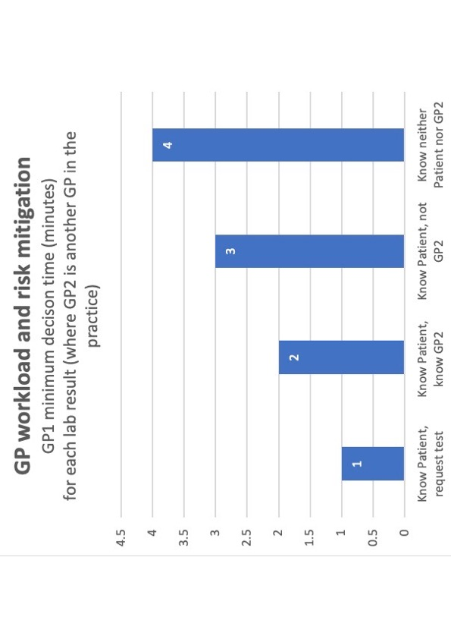
B
A
N
D
W
I
D
T
H
RISK
HANDOVERS

Slide 4

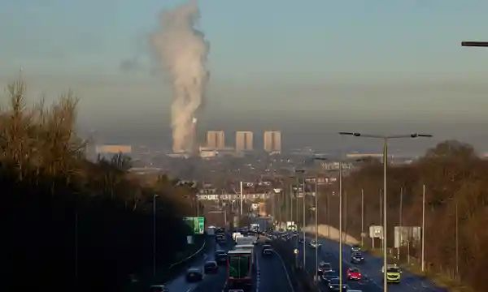
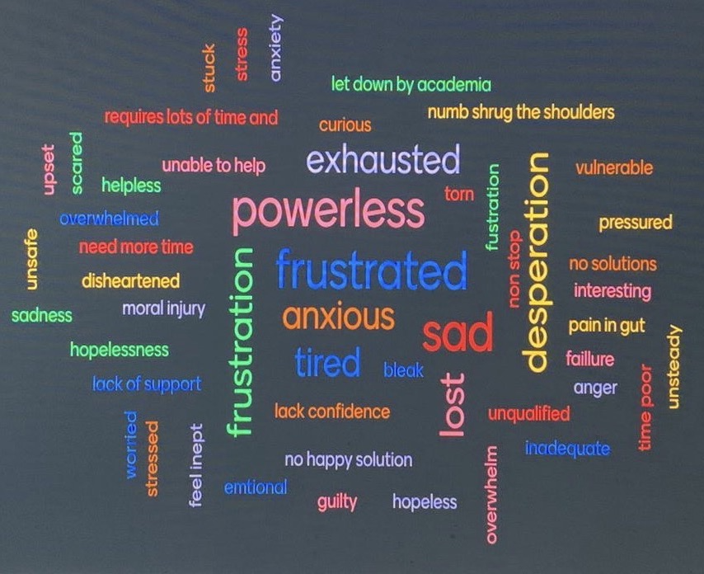
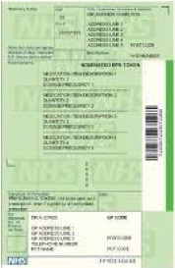
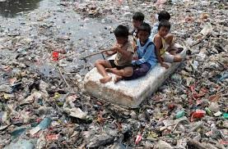


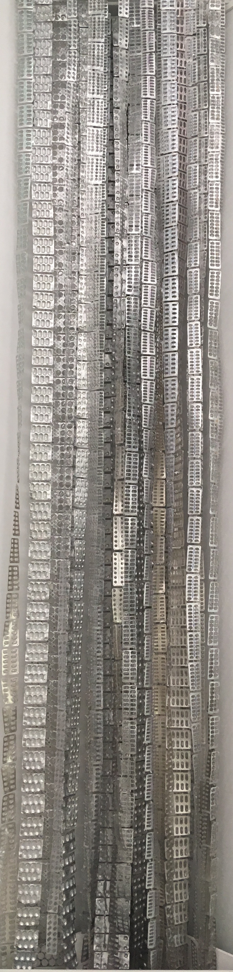
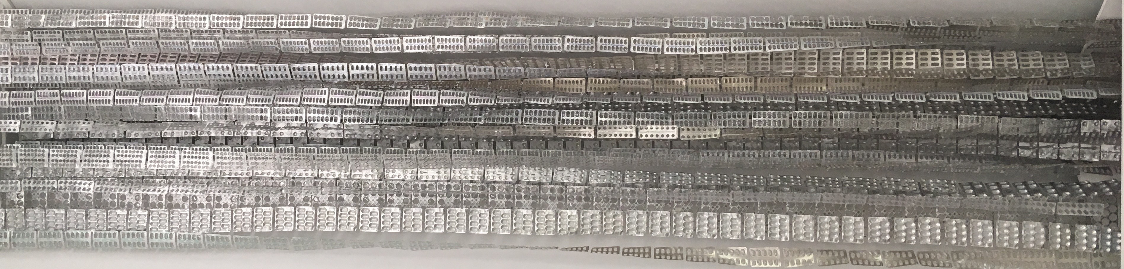
A conservative estimate of non-recyclable medicine plastic waste
September 2019 – a practice 13,000 patients:
800 scripts/week
3 items/script
2 tablet blister plastic packs/item
4,800 blister packs/week
19,200 blister packs/month
230,400 blister packs/year
2016 England - 1,104 Million items dispensed in the community
>2,000 Million blister packs into landfill, the sea or incinerated
Time
Goodwill
Trust
Creativity
Bandwidth
Blame
Harm
RISK
Harm
Bandwidth
Blame
Goodwill
Creativity
TIME
Trust
Blame
Blame
RISK
RISK
Multiple Handovers
Blame
Blame
Blame
RISK
Wasted opportunities with patients for conversations inviting change
Notes:
Our traumatised working as we recycle patient problems
Word Cloud GP in areas of deprivation: patients consult more, are less enabled after consultations, primary care teams are more stressed, and the environment especially air quality is worse
first Health Equity Festival – Restoring hope story by story https://www.bbbc.org.uk/insights/news-and-resources/news-and-resources-health-equity-festival/
Measuring wasted handovers – Commissioners could measure contacts EQUIP Database
Are we creating health or ill-health?
What we measures matters – could commissioners incentivise minimizing handovers?

Slide 5
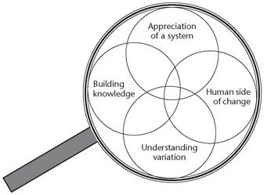
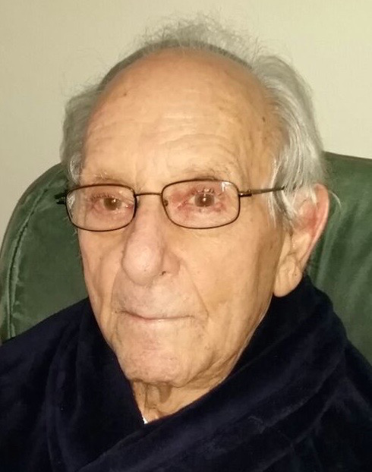
Make time to save time
Practice Partnership
Data informed
Patient Participation Group
GP Partner-Partner leadership buddy
GP
Partner
GP
Partner
Reception Admin
Reception Admin
GP
Partner
Older GPs
GP Registrar
Future Salaried
GP
GP
Salaried
Mr Roth
GP
Salaried
Future Salaried
GP
GP
Locum
GP
Locum
FTE List* 1,800 -2,000 patients *Deprivation: patients consult more
Annual Leave covered within the team
Yellow Team GP always on site, cover days of week
Families: mother/father/carer/children/siblings
Whole list i.e., all ages and all complexities: ‘Robin Hood’ time
Patients choose appointment time 5/10/15/20 min
Joint consultations: nurse/pharmacist/social prescriber
SEA, Safeguarding, Child protection, complaints, substance misuse
Share ‘soft intelligence’ from home visits
Frequent attenders – Recovery College
Team data – tests, admissions, A&E, referrals
Team Development Measure: highly functional
GP
Locum
GP
Locum
Micro-level
Practice
nurse
Social
prescriber
Pharmacist
Notes:
Resources that underpin this work
Fresh Doctors and cost-effective care https://handyapproachtocare.com/2018/07/06/fresh-doctors-and-cost-effective-care-in-tower-hamlets/
Micro-teams https://bjgplife.com/contribute/
Realising full potential of primary care https://bjgp.org/content/67/660/292
Understanding the impact of professional motivation on the workforce crisis in medicine: a rapid review https://bjgpopen.org/content/5/2/BJGPO.2021.0005
Continuity of care: a multidisciplinary review (Haggerty, Starfield) https://pubmed.ncbi.nlm.nih.gov/14630762/
Carbon Footprint Pathology testing https://pubmed.ncbi.nlm.nih.gov/32304240/
Team Development Measure https://www.peacehealth.org/about-peacehealth/medical-professionals/eugene-springfield-cottage-grove/team-measure/Pages/measure
Choosing wisely https://www.choosingwisely.co.uk/about-choosing-wisely-uk/
Salaried GP survey https://newhamgpvts.org.uk/
Adverse Childhood Experiences, Resilience and Trauma Informed Care: A Public Health Approach to Understanding and Responding to Adversity https://www.nhshighland.scot.nhs.uk/Publications/Documents/DPH-Annual-Report-2018_(web-version).pdf
Sharing control of appointment length with patients in general practice: a qualitative study https://pubmed.ncbi.nlm.nih.gov/23561785/
Recovery and Wellbeing College in practice https://slideplayer.com/slide/12644676/

Slide 6
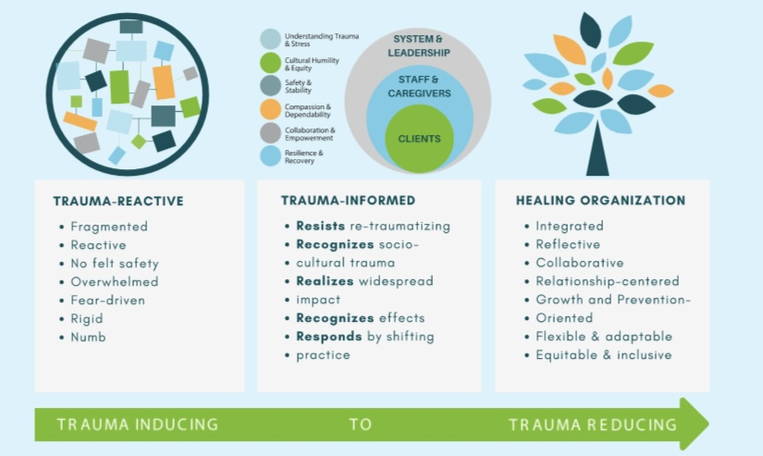
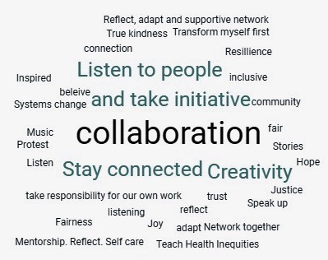
http://traumatransformed.org/wp-content/uploads/Copy-of-TOTIHO-Updated-040319-11x17_Healing-Organization-Chart.pdf
Notes:
Trauma Transformed, A program of East Bay Agency for Children. Healing Organization Chart. http://traumatransformed.org/wp-content/uploads/Copy-of-TOTIHO-Updated-040319-11x17_Healing-Organization-Chart.pdf
Measuring the Impact of Trauma-Informed Primary Care: Are We Missing the Forest for the Trees? https://www.chcs.org/resource/measuring-the-impact-of-trauma-informed-primary-care-are-we-missing-the-forest-for-the-trees/
cloud – Second health Equity Festival Harvesting sustainable seeds of change https://www.bbbc.org.uk/insights/news-and-resources/news-resources-health-equity-london-festival/
Working differently within the gift of the GP Independent contractor status
Revisit mission – we keep people well at home through managing uncertainty

Slide 7


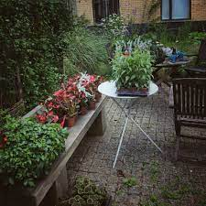
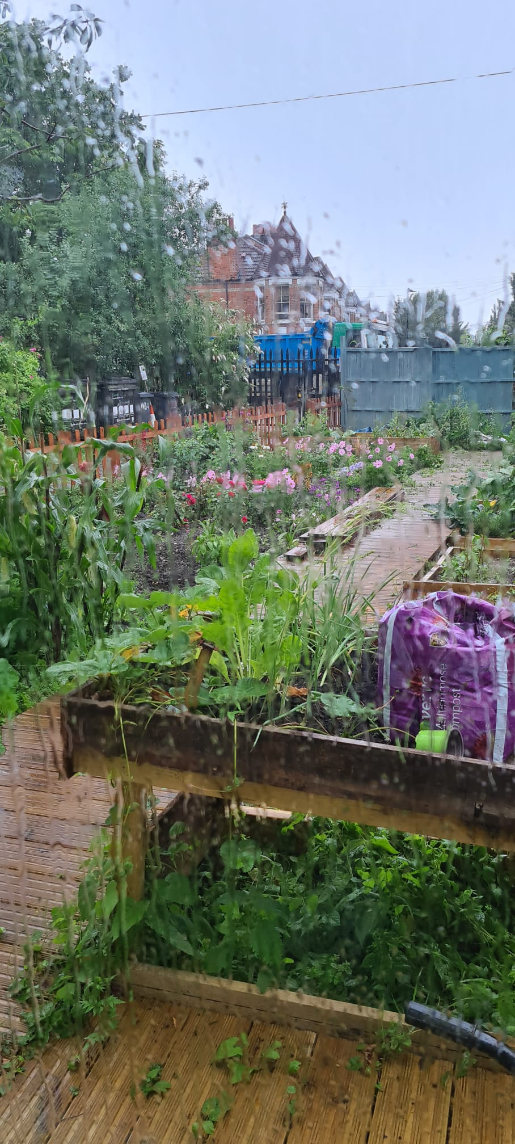
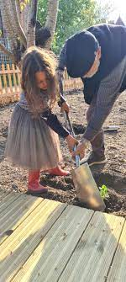
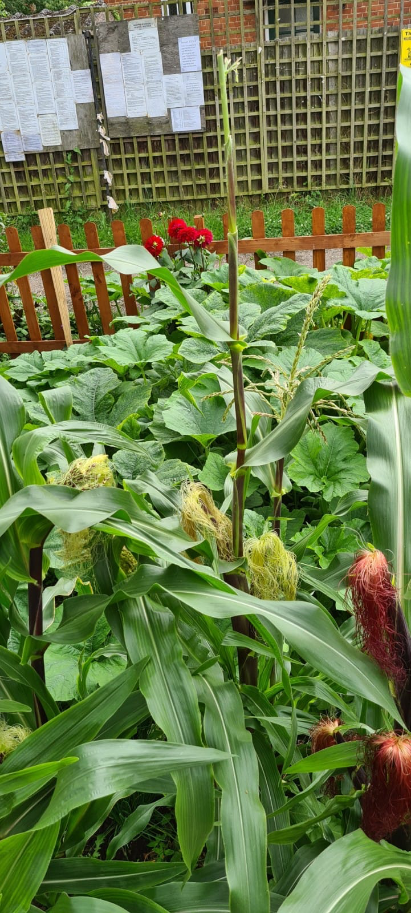

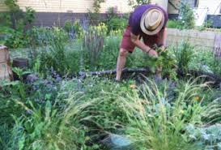


Dr Jane Myat
Dr Zohra Karim
Notes:
ACTION
What we could be doing instead – share risk with patients and create health
Health Creation Alliance https://thehealthcreationalliance.org
“I have rediscovered what I love about the NHS!” Altogether Better Leadership Programme https://www.altogetherbetter.org.uk/stories-about-collaborative-practice/2019/11/27/finding-the-joy-in-work-again
Didn’t ask for permission and not commissioned – why did they do it?
Restoration of health and health creation - ‘love for our patient, our profession, our world’
The Listening Space https://www.thelisteningspace.uk/

Slide 8
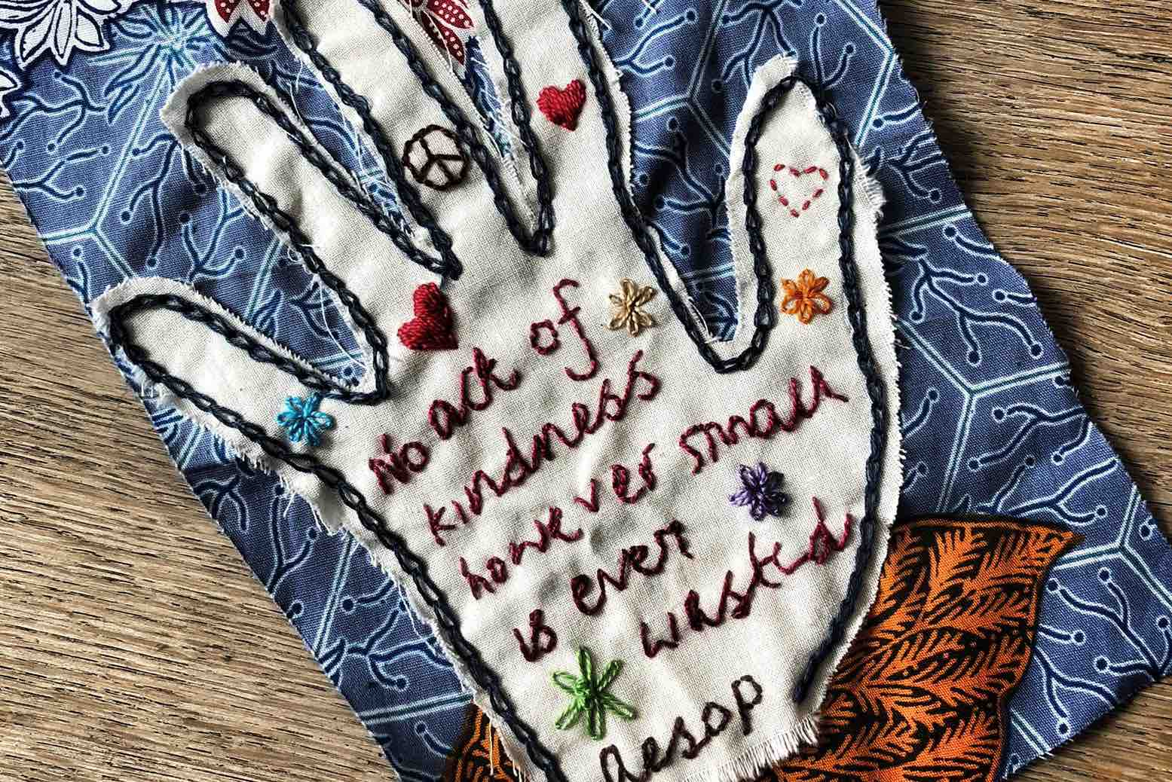
Notes:
GP Transition Hubs https://bhma.org/making-social-prescribing-work/#

Slide 9
Appendices
Micro- GP team win-wins
Micro- GP team FAQ
Revisit mission primary care – keep people well at home
Measuring and understanding variation across micro-GP teams

Slide 10
Micro-GP Team win-wins https://handyapproachtocare.com
Access | Reduce access at a micro-level, opportunities to have conversations inviting change, trauma informed care approach manage anxiety of frequent attenders
GP Retention Appraisal GMC | Belonging – relating to a known group of GPs and being ‘known’ and relating to a known group of GPs Competency – learning from colleagues Autonomy - to test ideas for scale up
CQC | Increased safety, second opinion, less handovers/handoffs (Safeguarding reviews show poor care associated with multiple handovers), virtual platform can enable connectivity for GPs who need to shield/ work from home
Commissioning | Reduce system costs through less: tests, investigations, referrals
Environment | Less waste, reduced carbon footprint through less visits, less prescriptions opportunities to work more closely with social prescribers Data can track hand over e.g., number of clinical contacts
Quality of care | Shared decisions with patients with a known group of GPs, less anonymous especially in areas of deprivation, share different and complementary styles of working, reduce overdiagnosis and overtreatment
Three-dimensional knowledge and learning | Meaning, mastery, motivation, and curiosity through tracking of patient symptom trajectory, share ‘soft-intelligence’ from visits, can expand on ‘thin’ clinical record which is short on the details of the lived life of patients especially if only known on a digital platform, provide interpretational care
GP Partners | Succession planning embedded early throughout the system, incentivise small teams, different role as leaders in bringing information from the centre into the team
Salaried GPs | Sense of ownership and control, reveal talents and interests, build commitment to their patient list, develop management skills
Locums | Sense of belonging and inclusion - come into same team each time when cover at practice, learn about cases, constructive feedback to support leaning and commitment
Older GPs | Retain in micro-team as step down/ reduce sessions, can bring expertise, knowledge of lived life of patient, contribute in different way e.g., clinical supervision in high-risk cohorts
QI | Small team test of ideas which can then scale up
1.

Slide 11
2. Micro-GP Teams - FAQ
1. Who gets to make the decision about GP micro-teams?
Varies but in most practices currently it is GP Partners who make these decisions
2. How do you deal with differences in styles of working?
Turn different styles in an opportunity to improve safety and/or reduce waste tests, referrals
3. What if there is conflict?
Get mediation.
4. How can teams work together well?
Use the Team Development Measure - cohesion/communication/roles and goals/team primacy. Learning needs to be addressed around respect, civility, mutual regard and co-creation of health
5. How do you set up micro-teams?
Group GPs into teams based on days of the week work so that each team covers the whole week based on GP micro-team for +/- 2,000 list.
6. Do patients get to choose which team to be in?
Ideally yes and can be a communication opportunity to coach patients in how teams work and how to use the practice and other resources
7. What is the role of the GP Partner in the micro-team?
Two levels as a co-clinician and as a leader from the centre i.e., bringing information from the Practice/PCN into the GP micro-team to enhance belonging in a wider system
8. How do other members of the wider EPCT fit in?
Ideally all GP micro-teams to have a dedicated admin/reception person who knows their list. Depending on size of practice and number of GP micro-teams will determine whether other roles i.e., PN, social prescribers, pharmacists work are dedicated to a single GP micro-team or have a case list across teams
9. Can GP micro-teams be incentivised financially?
Yes, practices can devolve funds to GP micro-teams to use QI to test creative ideas for sustainable care
10. What is the role of commissioners in the setting up of GP micro- teams?
Commissioners need to shift to measuring care based on the carbon footprint of clinical contacts across pathways spanning models of care which will capture opportunities to reduce waste in the system through minimising handovers
11. How will we know GP micro-teams are making a difference to patient care?
Use Team Development Measure and GP sense of personal achievement (Maslach inventory) as proxy for patient care
Notes:
Team Development Measure https://www.peacehealth.org/about-peacehealth/medical-professionals/eugene-springfield-cottage-grove/team-measure/Pages/measure
For Short 10 question version see https://handyapproachtocare.com/2018/07/06/a-handy-approach-quick-ways-of-learning-in-time-limited-environments/

Slide 12
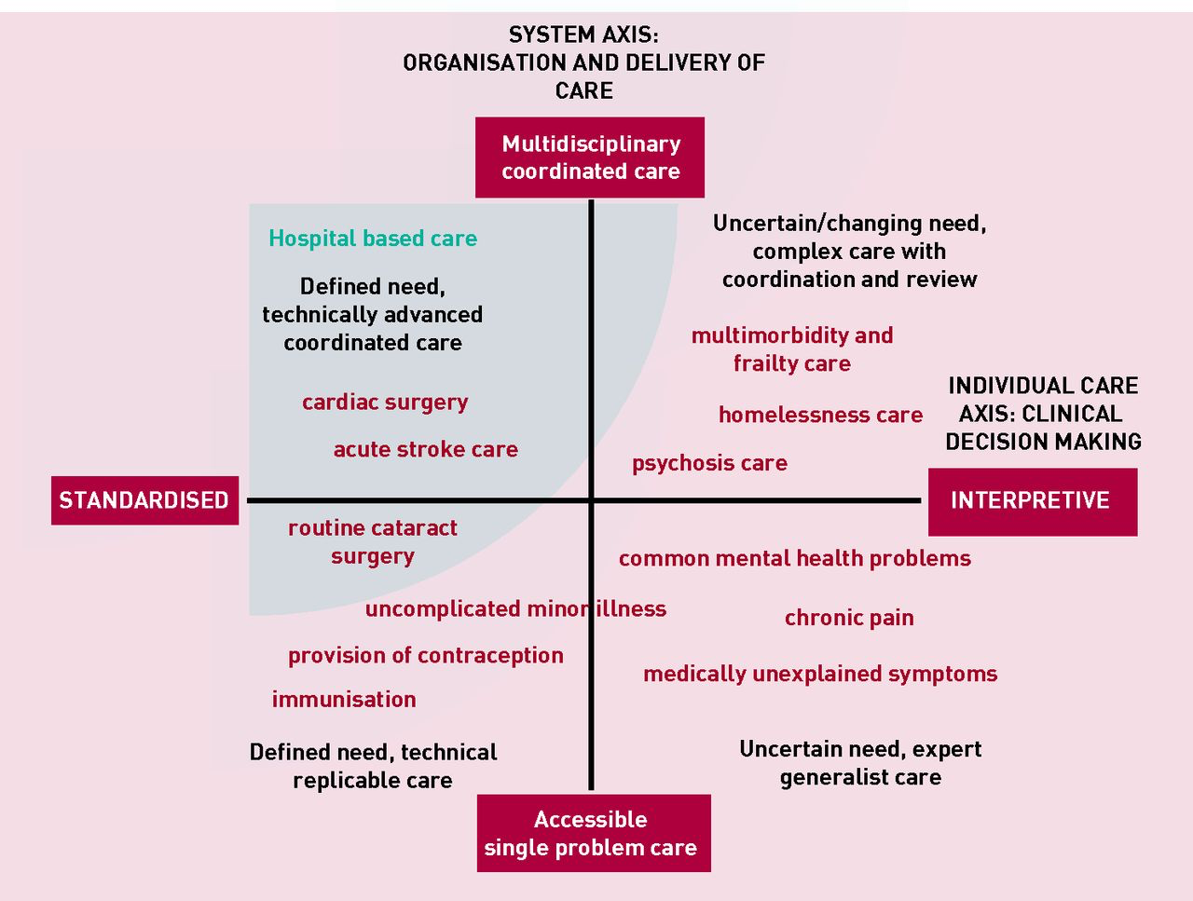
3. Revisit mission primary care – keep people well at home
Realising the full potential of primary care: uniting the ‘two faces’ of generalism. BJGP 2017
Joanne Reeve and Richard Byng
Notes:
Realising the full potential of primary care: uniting the ‘two faces’ of generalism BJGP 2017
Joanne Reeve and Richard Byng
http://bjgp.org/content/bjgp/67/660/292.full.pdf
The ‘Systems Axis’ (on the Y axis) describes a continuum from single problem accessible care through to integrated coordinated care bringing different skills and TEAMS together.
The ‘Individual Care Axis’ (on the X axis) recognises a continuum from standardised, replicable and often evidence informed, to highly-individualised interpretative care. This axis recognises that standardised disease-focused (guideline) medical care, even done well, can have a burdensome effect on individuals. Burden comes in many forms; whether as over-investigation and over-treatment, or as a failure to adequately address illness experiences that disrupt daily living (a failure of person-centred care). The two models at each end of the axis represent distinct forms of clinical reasoning that ask different questions and are underpinned by different epistemological approaches. In reality, primary care clinicians are often required to move along the continuum in response to particular patient needs.
We thus describe four quadrants with distinct categories of care provision . ‘Single problem/standardised care’ delivers low intensity accessible care at volume, mainly but not only in primary care; and increasingly achieved through technology- supported self-care (for example, blood pressure monitoring, contraception advice) and deployment of less highly-qualified staff (for example, fractures, minor illness). ‘Integrated/standardised care’ sees well- coordinated teams providing access to, and delivery of, condition-specific treatment whether acute management of myocardial infarction or surgical replacement of joints or valves. In both cases, interpretive skills are a lower priority.
Some patients, for example those with mild to moderate mental health needs or medically unexplained chronic pain need ready access to professionals skilled in interpretive practice. Professionals who are able to integrate biomedical, psychosocial, patient and professional accounts of illness in order to help patients make sense of, and so take an active part in managing, their own health problems. Patients in this ‘Accessible/Interpretive’ quadrant may benefit from signposting to services outside of medical care, but generally don’t need high levels of integrated care across medical teams. Some need ongoing continuity of care, while for others a single contact can provide timely treatment, reassurance or diversion from unnecessary investigation or medicine.
Patients with chronic complex care needs, especially those with diminished capacity to manage daily living (for example, multimorbidity, severe mental illness, homelessness), need both coordinated/ integrated and interpretive care. Medicine in this quadrant requires expert practitioners able to make decisions with patients, and work across teams taking account of shifting needs in the social, emotional, and biological domains. This approach should help prioritise needs and support choices to do less medicine, so avoiding the iatrogenic harm arising from a failure to tailor care to the individual-in-context.

Slide 13
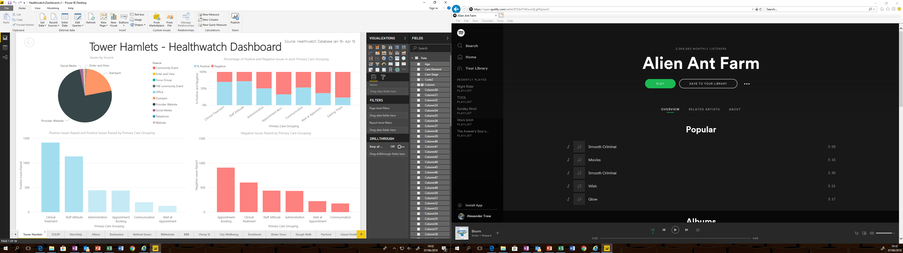
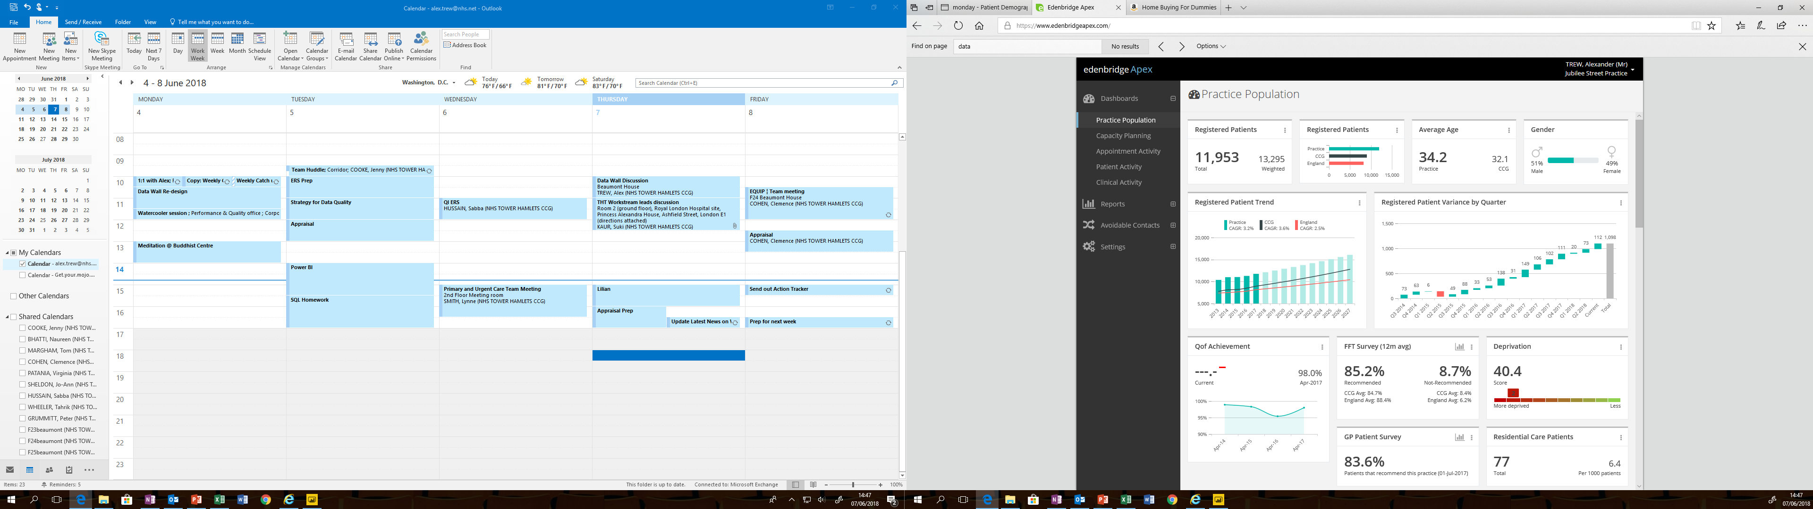
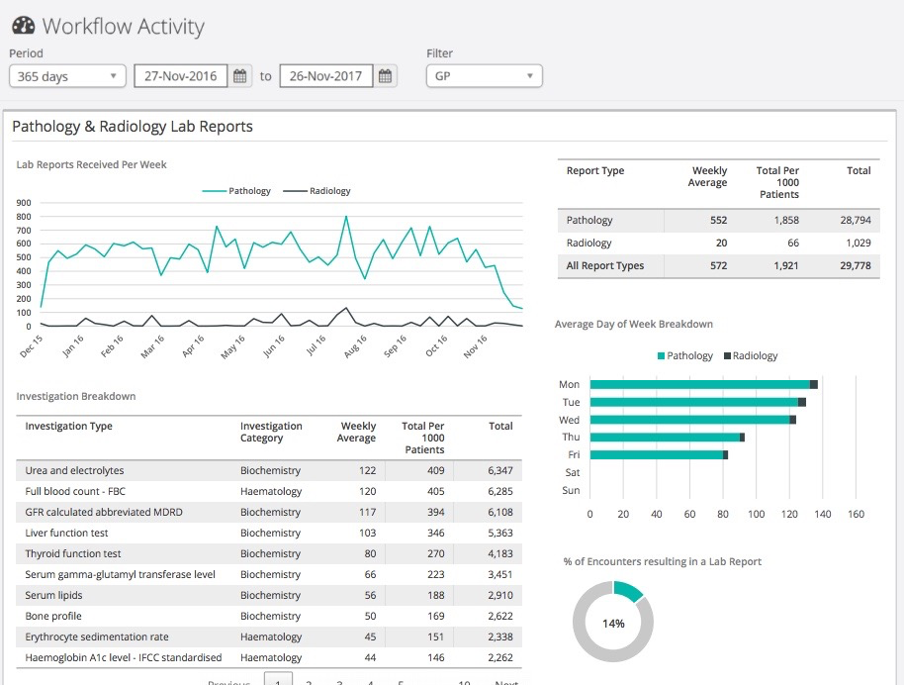
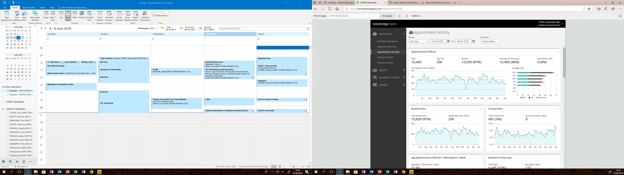
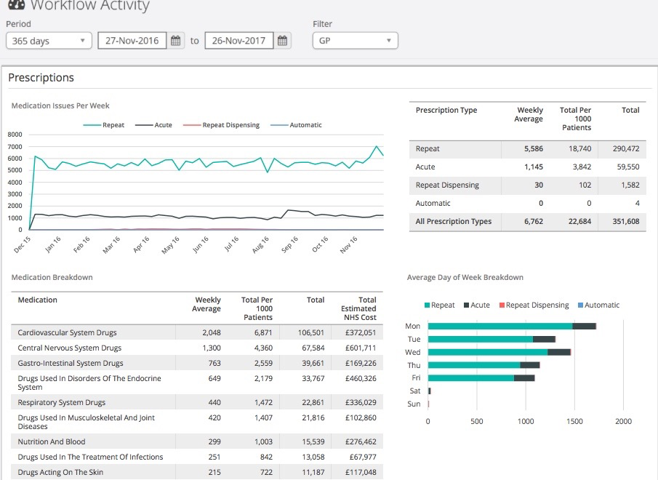
4. Measuring and understanding variation across micro-GP teams
Patient Experience
Practice Population
EDENBRIDGE
EQUIP
Diagnostics Activity
Appointment Activity
Medicines Activity
Notes:
https://equiptowerhamlets.nhs.uk/edenbridge/

